Slide 1
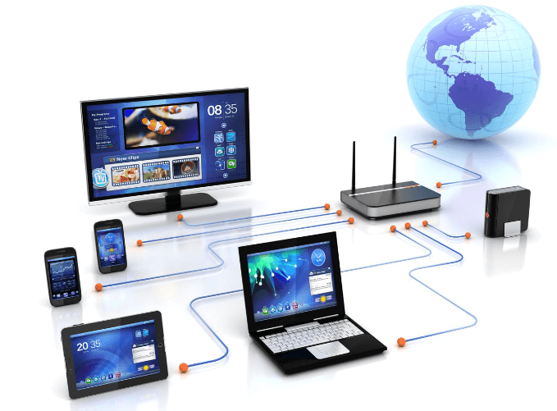
Computer Networks (22CS4PCCON)

Slide 2
SYLLABUS
Unit No. | Topics | Hrs.
1 | Introduction: Data Communications, Networks, Network Types, Network Models, Protocol Layering, TCP/IP Protocol Suite, OSI Model. Physical Layer: Data and signals Digital Transmission, (D-D Conversion) Bandwidth Utilization, Multiplexing, Switching, Circuit Switched Networks, Packet Switching. | 8
2 | Data Link Layer: Link Layer Addressing, Error Detection and Correction, Block Coding, Cyclic Codes, Checksum. Data Link Control: DLC Services, Data-Link Layer Protocols, Media Access Control, Wired LANs, Ethernet protocol. | 8
3 | Network Layer: Network Layer Services, Packet Switching, Network Layer Performance, IPV4 Addresses. Network Layer Protocols: Internet Protocol, ICMPV4, Unicast Routing, Routing algorithms, Unicast routing protocols, Internet Structure, Routing Information Protocol (RIP), Next Generation IP: IPV6 Addressing, IPV6 Protocol, ICMPv6 Protocol, Transition from IPV4 to IPV6 | 9
4 | Transport Layer: Transport Layer Protocols, User Datagram Protocol, Transmission Control Protocol. | 7
5 | Application Layer: Introduction, Standard Client Server Protocols. | 8

Slide 3
Text Books
Prescribed Text Book
Sl. No. | Book Title | Authors | Edition | Publisher | Year
1. | Data Communications and Networking 5E | Behrouz A Forouzan | Fifth | McGraw Hill | 2013
Reference Text Book
Sl. No. | Book Title | Authors | Edition | Publisher | Year
1. | Data and Computer Communication | William Stallings | Eight | Pearson Education | 2008
2. | Computer Networks – A Systems Approach | Larry L. Peterson and Bruce S. Davie | Fourth | Elsevier | 2007

Slide 4
Evaluation
Tool | Remarks | Marks
Internals | Best of TWO | 20
QUIZ | ONE | 05
Lab Component | TWO | 25
Alternate Assessment Tool |  | -
Total |  | 50

Slide 5
Laboratory Plan
Experiment # | Unit # | Name of Experiment | Remarks
 |  | CYCLE 1
1 | 2 | Create a topology and simulate sending a simple PDU from source to destination using hub and switch as connecting devices and demonstrate ping message.
2 | 3 | Configure IP address to routers in packet tracer. Explore the following messages: ping responses, destination unreachable, request timed out, reply
3 | 3 | Configure default route, static route to the Router
4 | 5 | Configure DHCP within a LAN and outside LAN. ,.
5 | 3 | Configure RIP routing Protocol in Routers
6 | 3 | Configure OSPF routing protocol
7 | 3 | Demonstrate the TTL/ Life of a Packet
8 | 5 | Configure Web Server, DNS within a LAN.
9 | 2 | To construct simple LAN and understand the concept and operation of Address Resolution Protocol (ARP)
10 | 5 | To understand the operation of TELNET by accessing the router in server room from a PC in IT office.
11 | 3 | To construct a VLAN and make the PC’s communicate among a VLAN
12 |  | To construct a WLAN and make the nodes communicate wirelessly
 |  | CYCLE - 2
13 | 2 | Write a program for error detecting code using CRC-CCITT (16-bits).
14 |  | Write a program for congestion control using Leaky bucket algorithm.
15 | 4 | Using TCP/IP sockets, write a client-server program to make client sending the file name and the server to send back the contents of the requested file if present.
16 | 4 | Using UDP sockets, write a client-server program to make client sending the file name and the server to send back the contents of the requested file if present.
17 | 3,4,5 | Tool Exploration -Wireshark

Slide 6
Observation book
- Aim of the experiment
- Topology
- Procedure
- Results
- Observation

Slide 7
Computer Networks
- Network
A network is a interconnection of devices that are capable of communicating among themselves.
- Computer Network
A computer network is a interconnection of computing devices that are capable of communicating and sharing resources among themselves.

Slide 8
Types of Networks
- Local Area Network
- Wide Area Network
- Metropolitan Area Network
- Internet

Slide 9
Advantages and Disadvantages
- Advantages
Sharing of Resources
Easy resource management
Increased performance
- Disadvantages
Security
Hardware and software setup costs

Slide 10
1.1 Data Communication
- Sharing of information
Local (face to face) or remote (tele-communication:tele far)
- Telecommunication: telephony, telegraphy, television
- Data- communicated information
- Data communication - exchange of data between two devices via some form of transmission medium such as a wire or cable.

Slide 11
Data Communication-Components
A data communications system has five components
1. Message
The information ( to be communicated )
Forms include text, numbers, pictures, audio, and video.
2. Sender
The device that sends the data message.
Ex: computer, workstation, telephone handset, video camera, and so on.

Slide 12
3. Receiver
The device that receives the message.
Ex: computer, workstation, telephone handset, television, and so on.
4. Transmission medium
The physical path by which a message travels from sender to receiver.
Ex: twisted-pair wire, co-axial cable, fiber-optic cable and radio waves.

Slide 13
5. Protocol
A protocol is a set of rules that govern data communications.
It represents an agreement between the communicating devices.
Without a protocol, two devices may be connected but not communicating

Slide 14
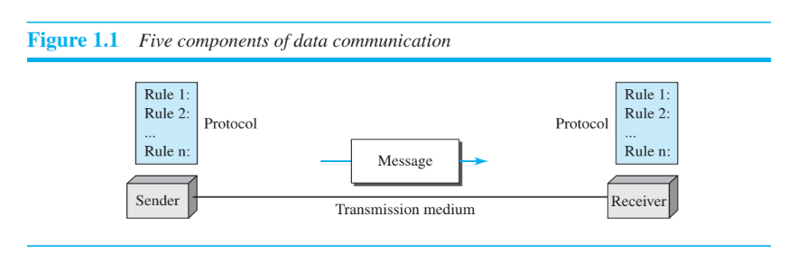

Slide 15
Data Representation
Different forms of data: text, numbers, images, audio, and video.
1. Text and numbers: Represented as a bit pattern, a sequence of bits (0s and 1s).
Different sets of bit patterns to represent text symbols.
Code-Each set Ex. ASCII –7 bits, Unicode –32 bits
Coding-the process of representing symbols.

Slide 16
2. Images represented by bit patterns.
An image is composed of a matrix of pixels (picture elements), where each pixel is a small dot.
The size of the pixel depends on the resolution.
Ex., an image can be divided into 1000 pixels (low resolution) or 10,000 pixels (high resolution-needs more memory)
Each pixel is assigned a bit pattern.

Slide 17
Black and-white dots (e.g., a chessboard), a 1-bit pattern is enough to represent a pixel.
Gray scale- 2-bit patterns-00 : black pixel, 01-a dark gray pixel, 10-a light gray pixel, 11-white pixel.
Color images- RGB combination of three primary colors: red, green, and blue.
The intensity of each color is measured, and a bit pattern is assigned to it.
YCM-combination of three other primary colors: yellow, cyan, and magenta

Slide 18
3. Audio: Audio refers to the recording or broadcasting of sound or music.
Diff: from text, numbers, or images. It is continuous, not discrete.
Ex, a microphone to change voice or music to an electric signal, we create a continuous signal.
4. Video: The recording or broadcasting of a picture or movie.
Video can either be produced as a continuous entity (e.g., by a TV camera), or it can be a combination of images, each a discrete entity, arranged to convey the idea of motion.

Slide 19
Data Flow
Data Flow Communication between two devices can be simplex, half-duplex, or full-duplex
1. Simplex: The communication is unidirectional, as on a one-way street.
Only one of the two devices on a link can transmit; the other can only receive.
Ex. Keyboards -only introduce input
Traditional monitors-only produce output.
Uses the entire capacity of the channel to send data in one direction.

Slide 20
2. Half-Duplex: Each station can both transmit and receive, but not at the same time.
When one device is sending, the other can only receive, and vice versa.
Like a one-lane road with traffic allowed in both directions. When cars are traveling in one direction, cars going the other way must wait.
The entire capacity of a channel is taken over by one of the two devices that is transmitting
• Ex. Walkie-talkies
• Used when there is no need for communication in both directions at the same time
• The entire capacity of the channel can be utilized for each direction.

Slide 21
3. Full-Duplex ( or Duplex):
In full-duplex mode (also called duplex), both stations can transmit and receive
like a two-way street with traffic flowing in both directions at the same time.
Signals going in one direction share the capacity of the link with signals going in the other direction.
This sharing can occur in two ways: Either the link must contain two physically separate transmission paths, one for sending and the other for receiving; or the capacity of the channel is divided between signals traveling in both directions.

Slide 22
Ex. One common example of full-duplex communication is the telephone network. When two people are communicating by a telephone line, both can talk and listen at the same time.
Used when communication in both directions is required all the time. The capacity of the channel must be divided between the two directions.

Slide 23
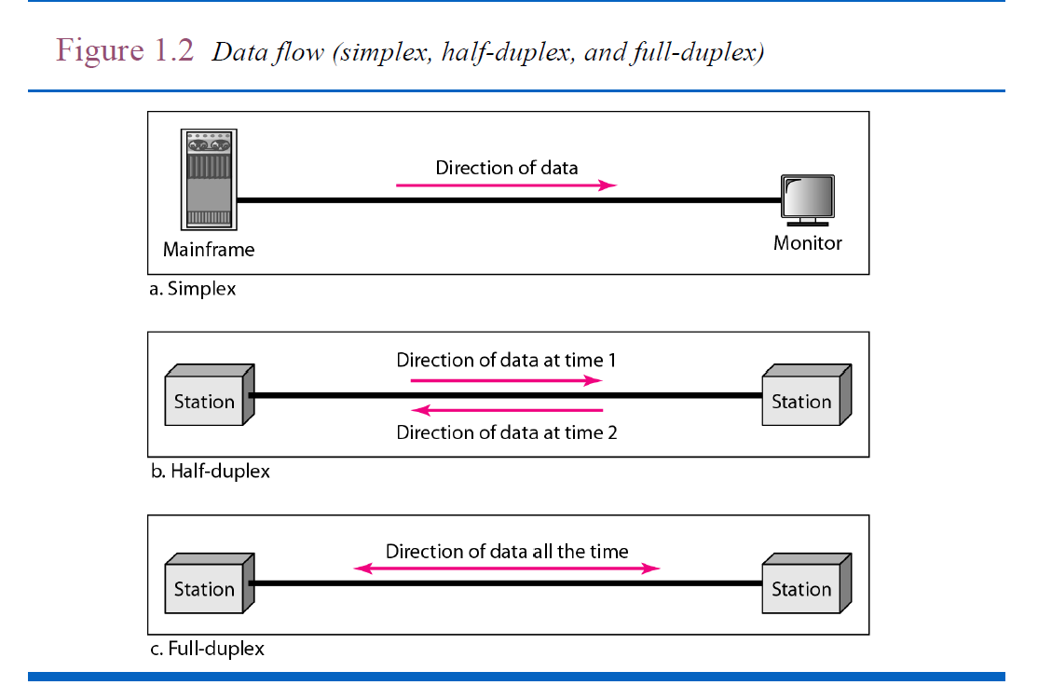

Slide 24
1.2 Networks
A network is the interconnection of a set of devices capable of communication.
A device can be a host(end system) large computer, desktop, laptop, workstation, cellular phone, or security system.
Connecting devices:
Router- connects the network to other networks
Switch- connects devices together
modem (modulator-demodulator), which changes the form of data, and so on.
devices are connected using wired or wireless transmission media such as cable or air.

Slide 25
1.2.1 Network Criteria
The most important of these are performance, reliability, and security.
1. Performance:
Performance can be measured in many ways including transit time and response time.
Transit time: amount of time required for a message to travel from one device to another.
Response time: elapsed time between an inquiry and a response.

Slide 26
The performance of a network depends on the following factors:
Number of users
Type of transmission medium
Capabilities of the connected hardware
The efficiency of the software
Performance is often evaluated by two networking metrics: throughput and delay.
We often need more throughput and less delay.

Slide 27
2. Reliability: Network reliability is measured by accuracy of delivery
The frequency of failure
The time it takes a link to recover from a failure
Network’s robustness in a disaster/calamity

Slide 28
3. Security:
Network security issues include protecting data from unauthorized access.
Protecting data from damage.
Implementing policies and procedures for recovery from breaches and data losses.

Slide 29
1.2.2 Physical Structures
Type of Connection
Two or more devices are connected through links.
A link is a communication pathway that transfers data from one device to another.
For communication to occur, two devices must be connected in some way to the same link at the same time.
There are two possible types of connections: point-to-point and multipoint.

Slide 30
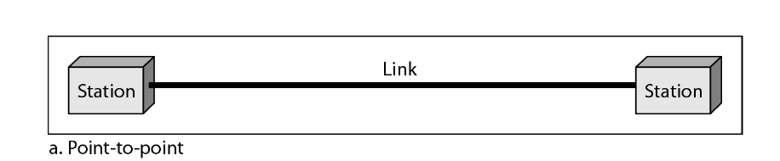
Point to point (P2P) Connection
Provides a dedicated link between two devices.
The entire capacity of the link is reserved for transmission between those two devices.
Changing television channels by infrared remote control -a point-to-point connection is established.

Slide 31
Multipoint Connection
A multipoint (also called multidrop) connection is one in which more than two specific devices share a single link
The capacity of the channel is shared, either spatially or temporally.
If the link is to be used simultaneously, it is a spatially shared connection.
If users must take turns, it is a timeshared connection.

Slide 32
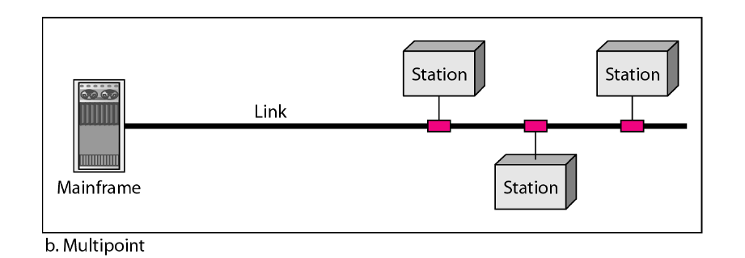

Slide 33
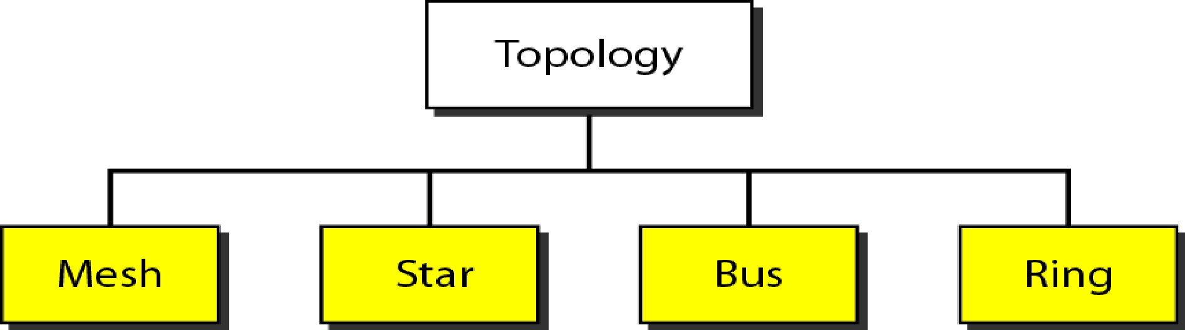
Physical Topology
Physical topology the way in which a network is laid out physically.
Two or more devices connect to a link
two or more links form a topology.
Topology is the geometric representation of the relationship of all the links and linking devices.

Slide 34
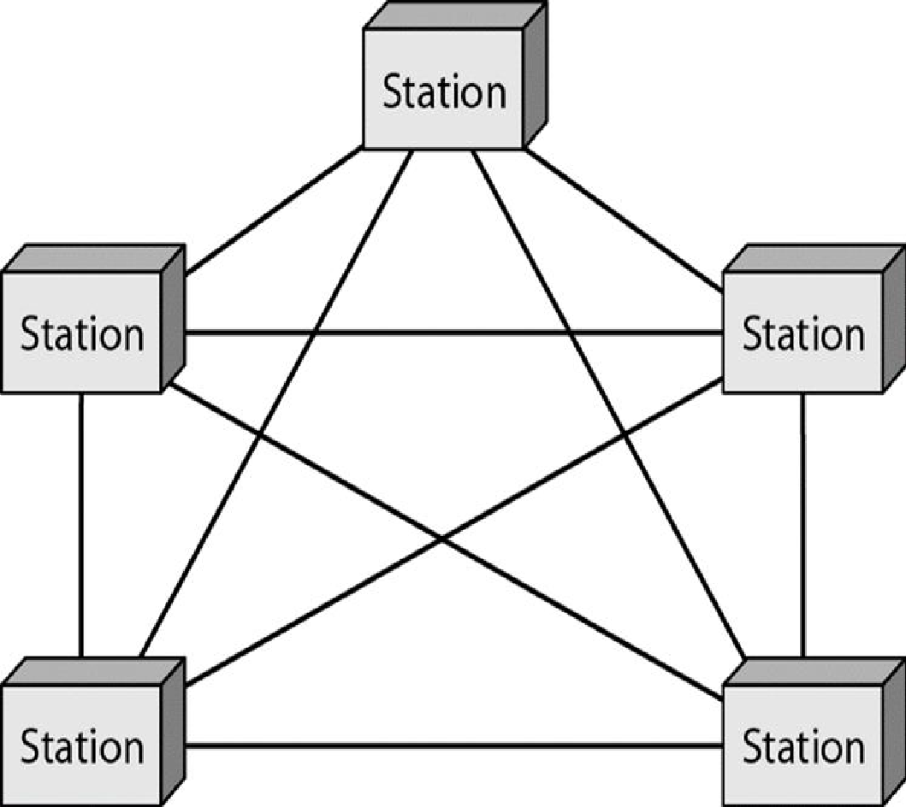
1. Mesh Topology
- Every device has a dedicated point-to-point link to every other device.
- We need n (n –1) physical links. If every link allows duplex. communication, then n(n-1)/2 links are seen.
- Every device must have n –1 input/output (I/O) ports.

Slide 35
Advantages and Disadvantages of Mesh
Advantages
Dedicated links guarantee that each connection can carry its own data load, thus eliminating the traffic problems.
Mesh topology is robust–failure of one link does not affect others.
Privacy or security is achieved-dedicated lines.
• Fault isolation easy.

Slide 36
Disadvantages
The amount of cabling and the hardware required is high.
Installation and reconnection are difficult.
Bulk of the wiring can be greater than the available space.
Hence, implemented in a limited fashion, for example, as a back bone connecting the main computers of a hybrid network that can include several other topologies.
One practical example-the connection of telephone regional offices in which each regional office needs to be connected to every other regional office.

Slide 37
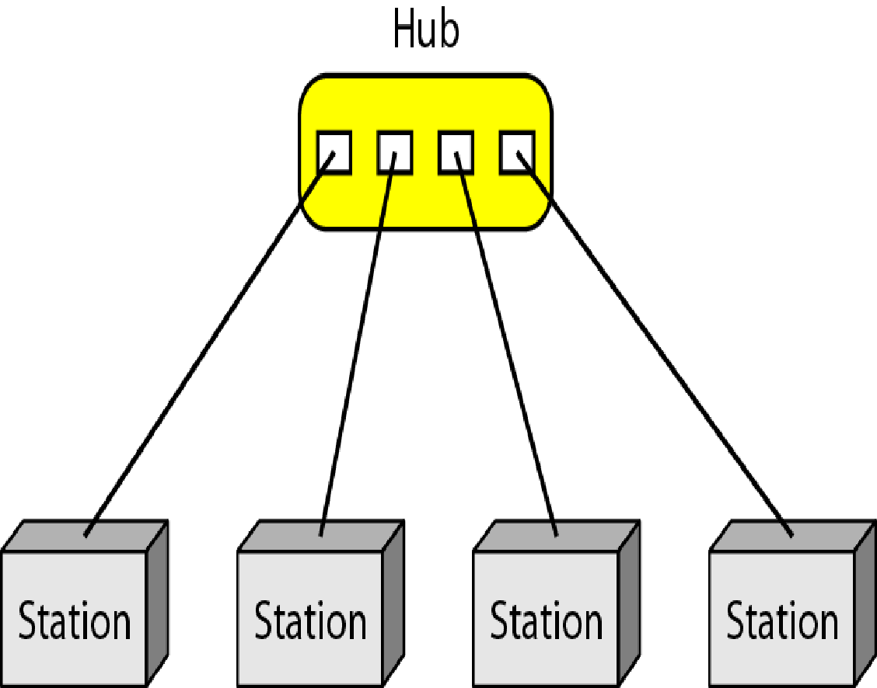
2. Star Topology
Each device has a dedicated point-to-point link only to a central controller, called a hub.
The devices are not directly linked to one another –no direct traffic between devices.
- Controller acts as an exchange: If Device1 wants to communicate to Device2, D1-> controller->D2
- The star topology is used in local-area networks (LANs).

Slide 38
Advantages
- Less expensive than a mesh topology each device needs only one link and one I/O port to connect it to any number of others (less cabling).
- Easy to install and reconfigure.
Additions and deletions involve only one connection: between that device and the hub.
- Robustness if one link fails, only that link is affected.
All other links remain active, easy fault identification and fault isolation.
When hub is working, it can be used to monitor link problems and bypass defective links.

Slide 39
Disadvantages
Dependency on one single point, the hub.
If the hub goes down, the whole system is dead.
Cabling is better than mesh but inefficient compared to ring or bus.
High-speed LANs often use a star topology with a central hub.

Slide 40
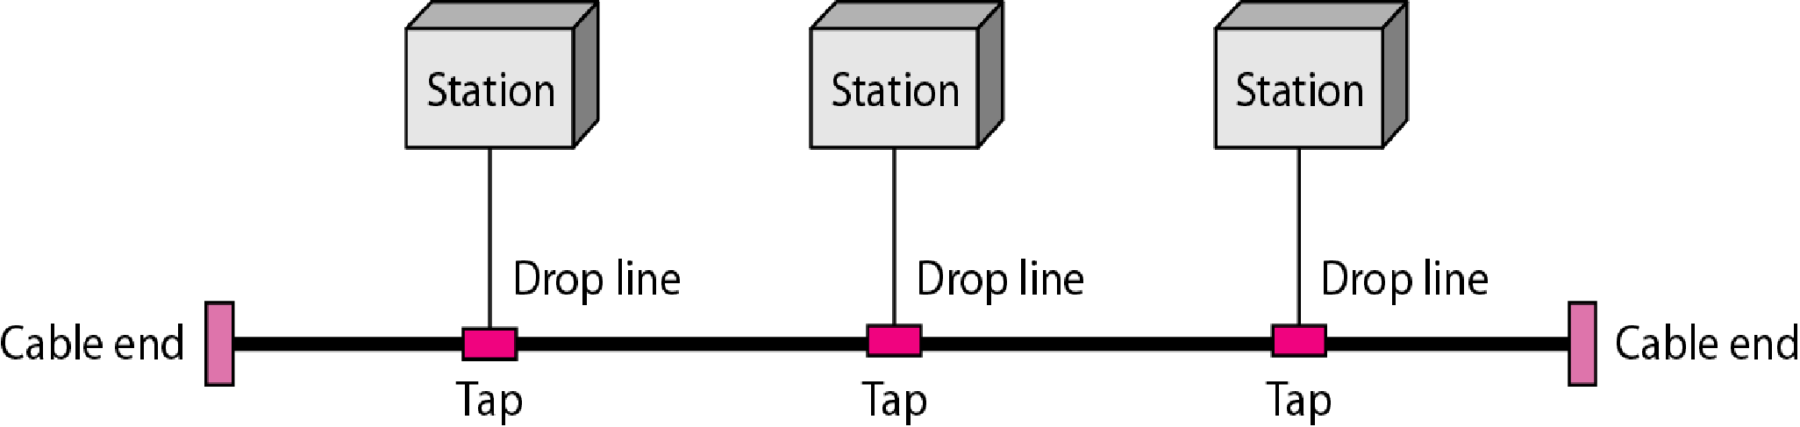
3. Bus Topology
- Star and mesh are point to point, Bus is multipoint.
- One long cable acts as a backbone linking all devices in a network.
- Nodes are connected to the bus cable by drop lines and taps.
- A drop line is a connection running between the device and the main cable.
- A tap is a connector that either splices into the main cable creating a contact with the metallic core.
- Limits on the number of taps a bus can support and on the distance between those taps

Slide 41
Advantages
Ease of installation.
Backbone cable can be laid along the most efficient path and nodes connect to this cable.
Less cabling and hardware required than mesh or star topologies.
Used in the design of local area networks. Traditional Ethernet LANs can use a bus topology

Slide 42
Disadvantages
Reconnection and fault isolation is difficult.
Signal reflection at the taps can cause degradation in quality.
Can be controlled by limiting the number and spacing of devices connected to a given length of cable.
Adding new devices may therefore require modification or replacement of the backbone.
A fault or break in the bus cable stops all transmission, even between devices on the same side of the problem.
The damaged area reflects signals back in the direction of origin, creating noise in both directions.

Slide 43
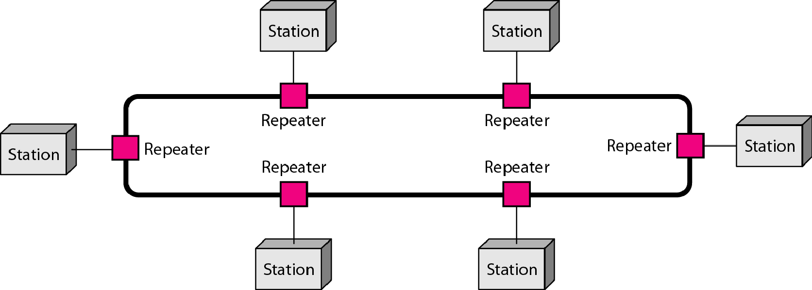
4. Ring Topology

Slide 44
Each device has a dedicated point-to-point connection with only the two devices on either side of it.
A signal is passed along the ring in one direction, from device to device, until it reaches its destination.
Each device in the ring incorporates a repeater-regenerates the received bits and passes them along.

Slide 45
Advantages
A ring is relatively easy to install and reconfigure.
Each device is linked to only its immediate neighbors (either physically or logically).
To add or delete a device requires changing only two connections.
Fault identification is easy. A signal is circulating at all times.

Slide 46
Disadvantages
Unidirectional traffic can be a disadvantage.
A break in the ring (such as a disabled station) can disable the entire network.
Solution: a dual ring or a switch capable of closing off the break.
Ring topology -IBM introduced its local-area network, Token Ring.

Slide 47
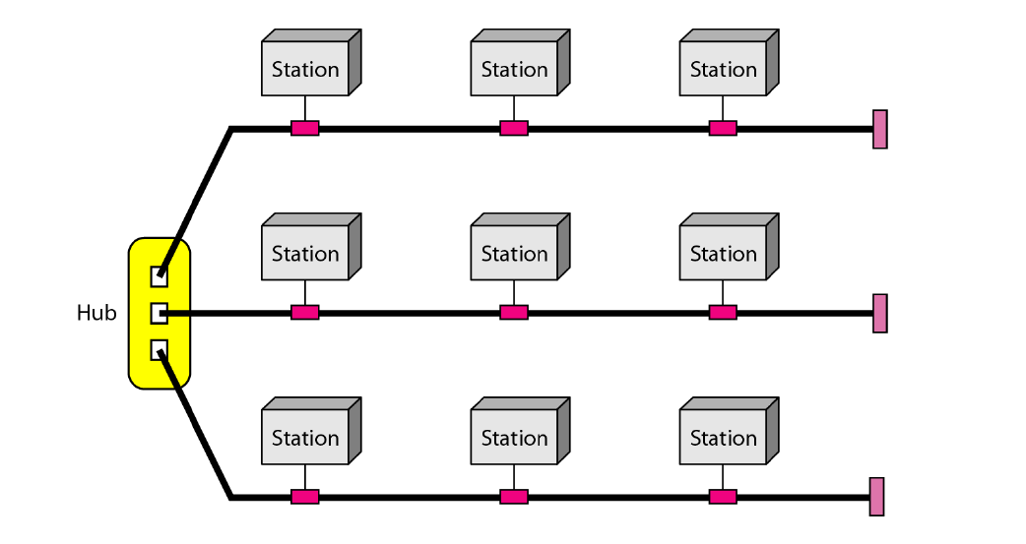
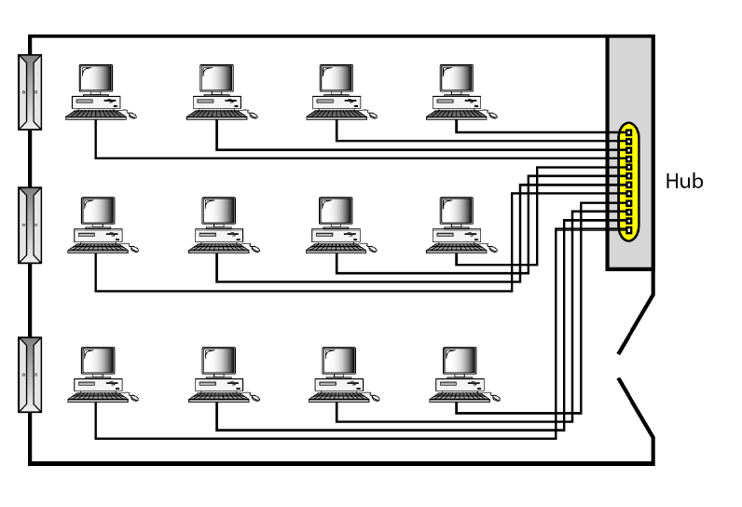
A star topology
A hybrid topology with star as a backbone

Slide 48
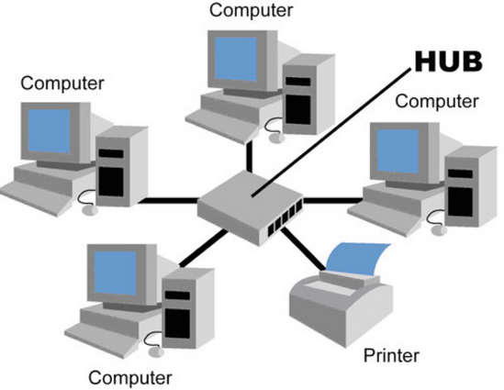
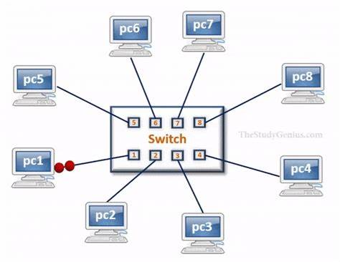
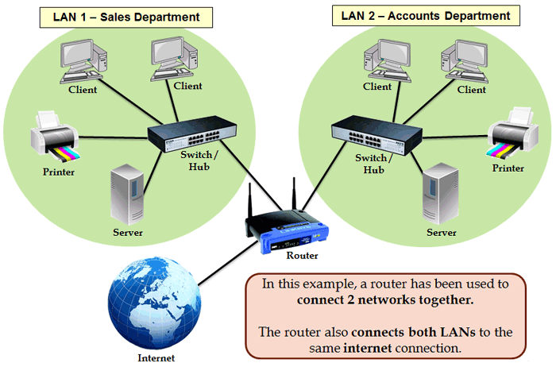
Connecting Devices

Slide 49
1.2 Network Types
Based on size, geographical coverage, and ownership, Networks can be divided into Local Area Network and Wide Area Network.
Local Area Network
Usually privately owned and connects some hosts in a single office, building, or campus.
Can be as simple as two PCs and a printer in someone’s home office or can extend throughout a company and include audio and video devices.
Resources are shared
Every host in the LAN is identified by a unique address
Every packet carries both the source host’s and the destination host’s addresses.

Slide 50
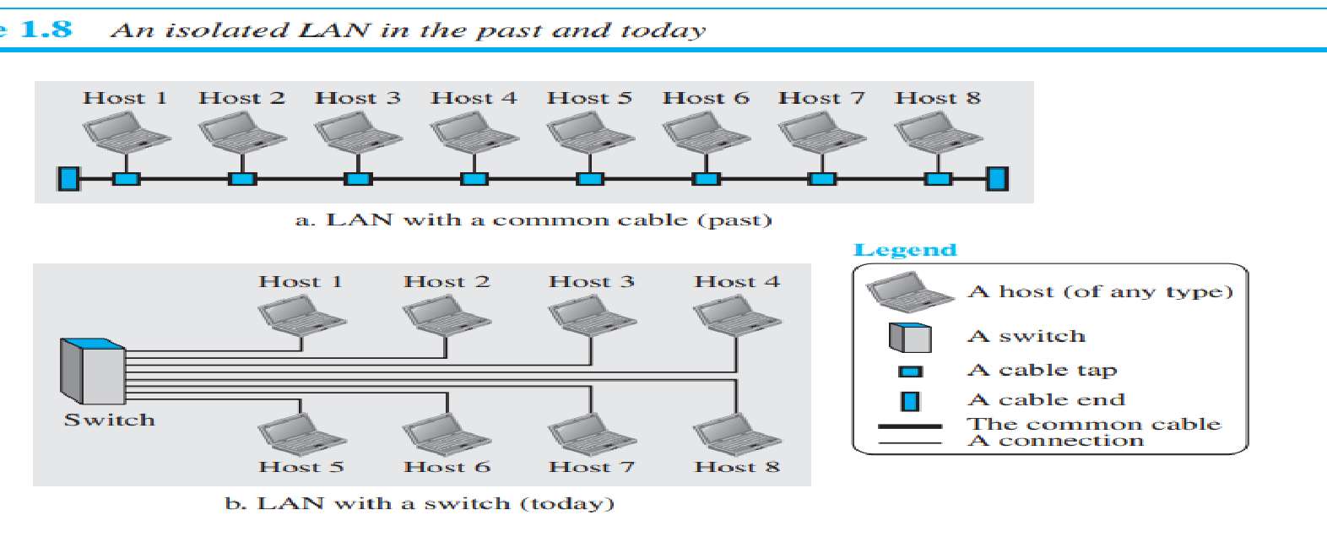
Earlier, a common cable connected all hosts, a packet sent from one host to another was received by all hosts. The intended recipient kept the packet; the others drop.
A smart connecting switch recognizes the destination address of the packet and guide the packet to its destination without sending it to all other hosts.

Slide 51
2. Wide Area Network (WAN)
Has a wider geographical span, spanning a town, a state, a country, or even the world.
A LAN interconnects hosts; WAN interconnects connecting devices such as switches, routers, or modems.
A WAN is normally created, owned and run by communication companies and leased by an organization that uses it.
Two distinct examples of WANs today: point-to-point WANs and switched WANs.

Slide 52
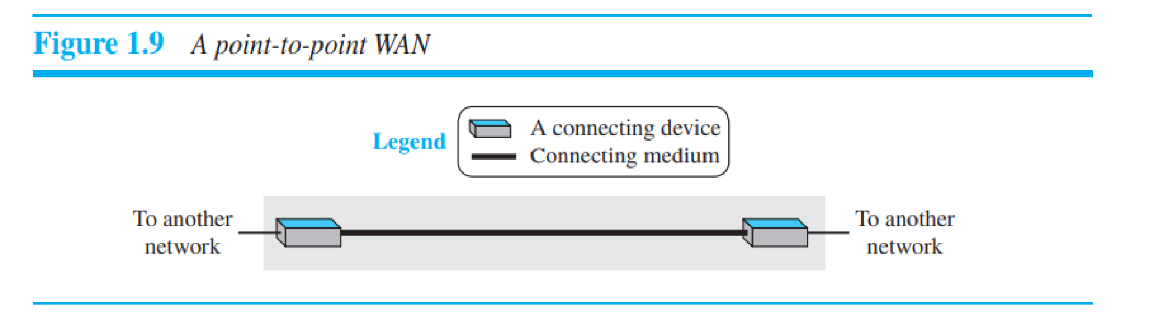
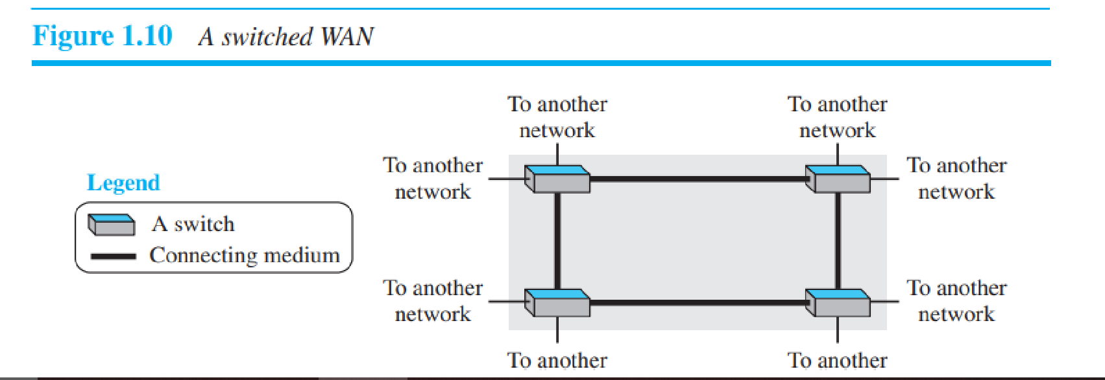

Slide 53
Point-to-Point WAN:
Network that connects two communicating devices through a transmission media (cable or air).
Switched WAN:
A switched WAN is a network with more than two ends.
A combination of several point-to-point WANs that are connected by switches.
Used in the backbone of global communication today.

Slide 54
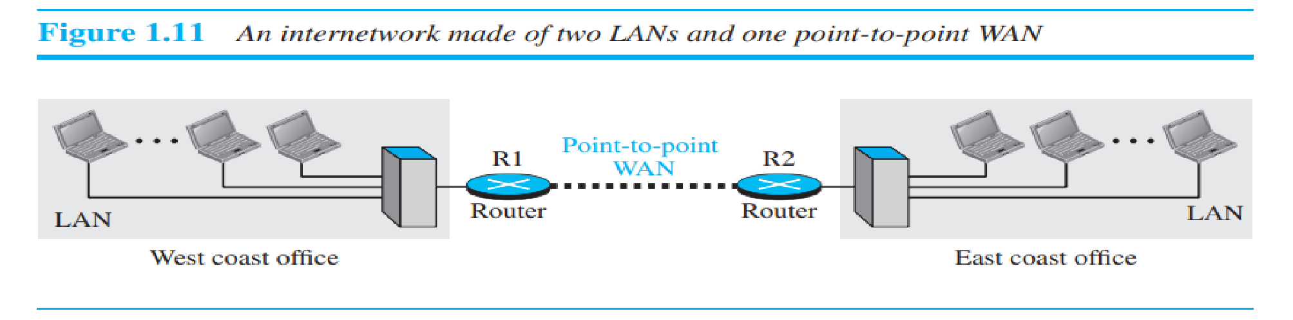
The Internetwork
When two or more networks are connected, they make an internetwork, or internet.
As an example, assume that an organization has two offices, one on the east coast and the other on the west coast.
Each office has a LAN that allows all employees in the office to communicate with each other.

Slide 55
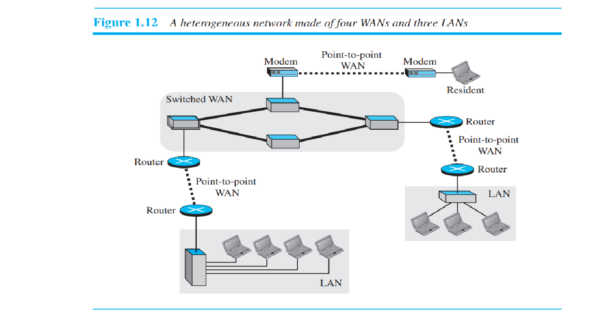

Slide 56
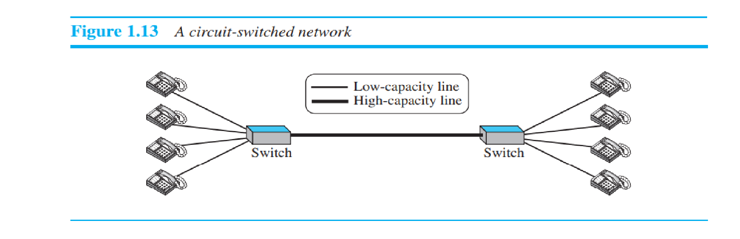
1.3.3 Switching
A switch connects 2 or more links together.
Two most common types of switched networks: circuit switched and packet switched networks .

Slide 57
Circuit-Switched Network
a dedicated connection, called a circuit, is always available between the two end systems;
The switch can only make it active or inactive.
Circuit switching was very common in telephone networks in the past.
Thick line -is a high-capacity communication line that can handle four voice communications at the same time
The capacity can be shared between all pairs of telephone sets.
Forwarding tasks but no storing capability.
Two cases: All four to four communication-the capacity of the thick line is fully used.
Only one to one -only one-fourth of the capacity of the thick line is used.
Is efficient only when it is working at its full capacity;
Most of the time, it is inefficient because it is working at partial capacity.
If link capacity is reduced, then communication cannot happen for all

Slide 58
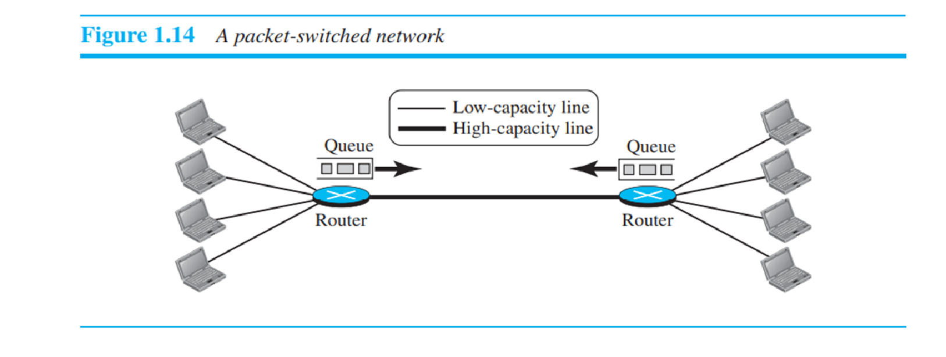
Packet Switched Network

Slide 59
In Computer network, the communication between the two ends is done in blocks of data called packets.
Router function -both storing and forwarding because a packet is an independent entity that can be stored and sent later.
A router in a packet-switched network has a queue that can store and forward the packet.
When the requirement is less than or equal to link capacity, no waiting required.
When the requirement is more than the capacity of the link, packets should be stored and forwarded.
Packet-switched network is more efficient than a circuit switched network, but the packets may encounter some delays.

Slide 60
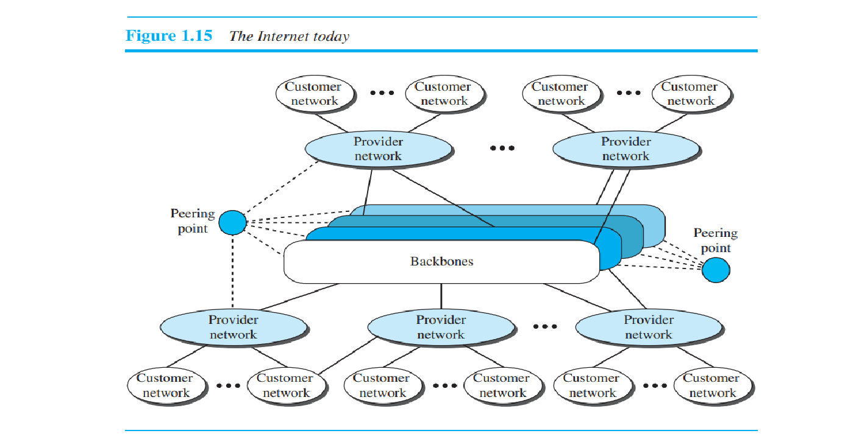
1.3.4 The Internet

Slide 61
Top level
The backbones are large networks owned by some communication companies such as Sprint, Verizon (MCI), AT&T, and NTT.
The backbone networks are connected through some complex switching systems -peering points.
Second level
Provider networks
Smaller networks that use the services of the backbones for a fee.
Connected to backbones and sometimes to other provider networks.
Third level
customer networks–Service users by paying a fee
Backbones and provider networks
International ISPs-backbones
National or regional ISPs -provider networks

Slide 62
Accessing the Internet
The physical connection is normally done through a point-to-point WAN.
Using Telephone Networks
Dial Up Service
modem added to telephone line
DSL Service
For high speed internet
Using Cable Networks
Using Wireless Networks
Direct Connection to the Internet
Large organization or corporation can become a local ISP

Slide 63
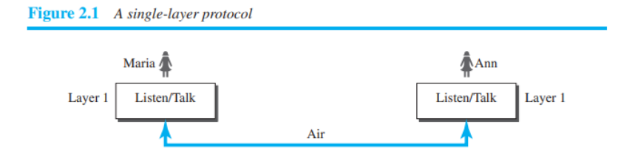
Network Models- Protocol Layering
• Protocol: Rules that both the sender and receiver and all intermediate devices need to follow to be able to communicate effectively
• Face to face communication

Slide 64
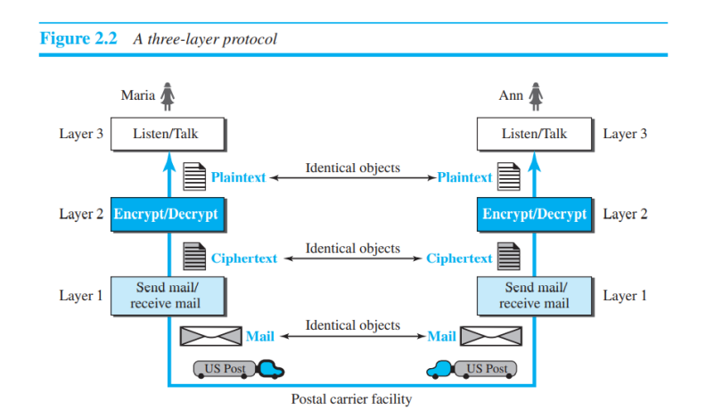

Slide 65
Need for Layered Architecture
Modularity
Bring together the devices from different vendors
Ease of implementation

Slide 66
Principles of Protocol Layering
First principle
For bidirectional communication- each layer should be able to perform two opposite tasks, one in each direction.
In Fig, listen/talk in layer 3, enc/dec in layer2 and send/rece in layer 1
• Second principle
the two objects under each layer at both sites should be identical.

Slide 67
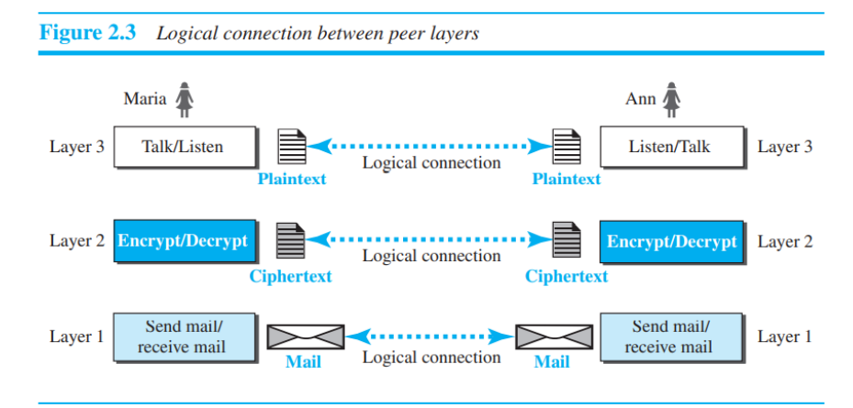
Logical Connections
a logical (imaginary) connection at each layer is established through which they can send the object created from that layer.

Slide 68
TCP/IP PROTOCOL SUITE
TCP/IP is a protocol suite (a set of protocols organized in different layers) used in the Internet today.
It is a hierarchical protocol made up of interactive modules, each of which provides a specific functionality.
Hierarchical - each upper level protocol is supported by the services provided by one or more lower level protocols.
Original suite -four software layers built upon the hardware. Host-to-network, Internet, Transport and Application.
Today- a five-layer model.

Slide 69
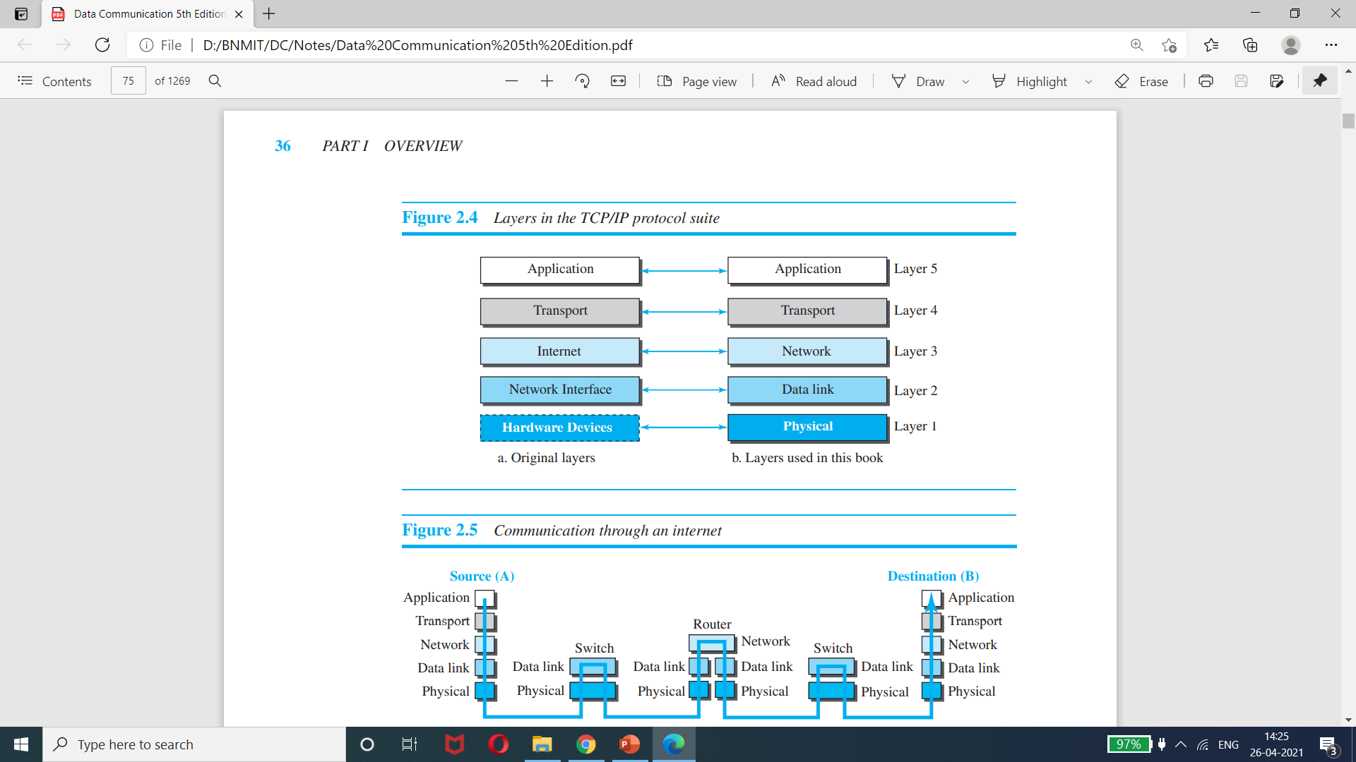
Layered Architecture

Slide 70
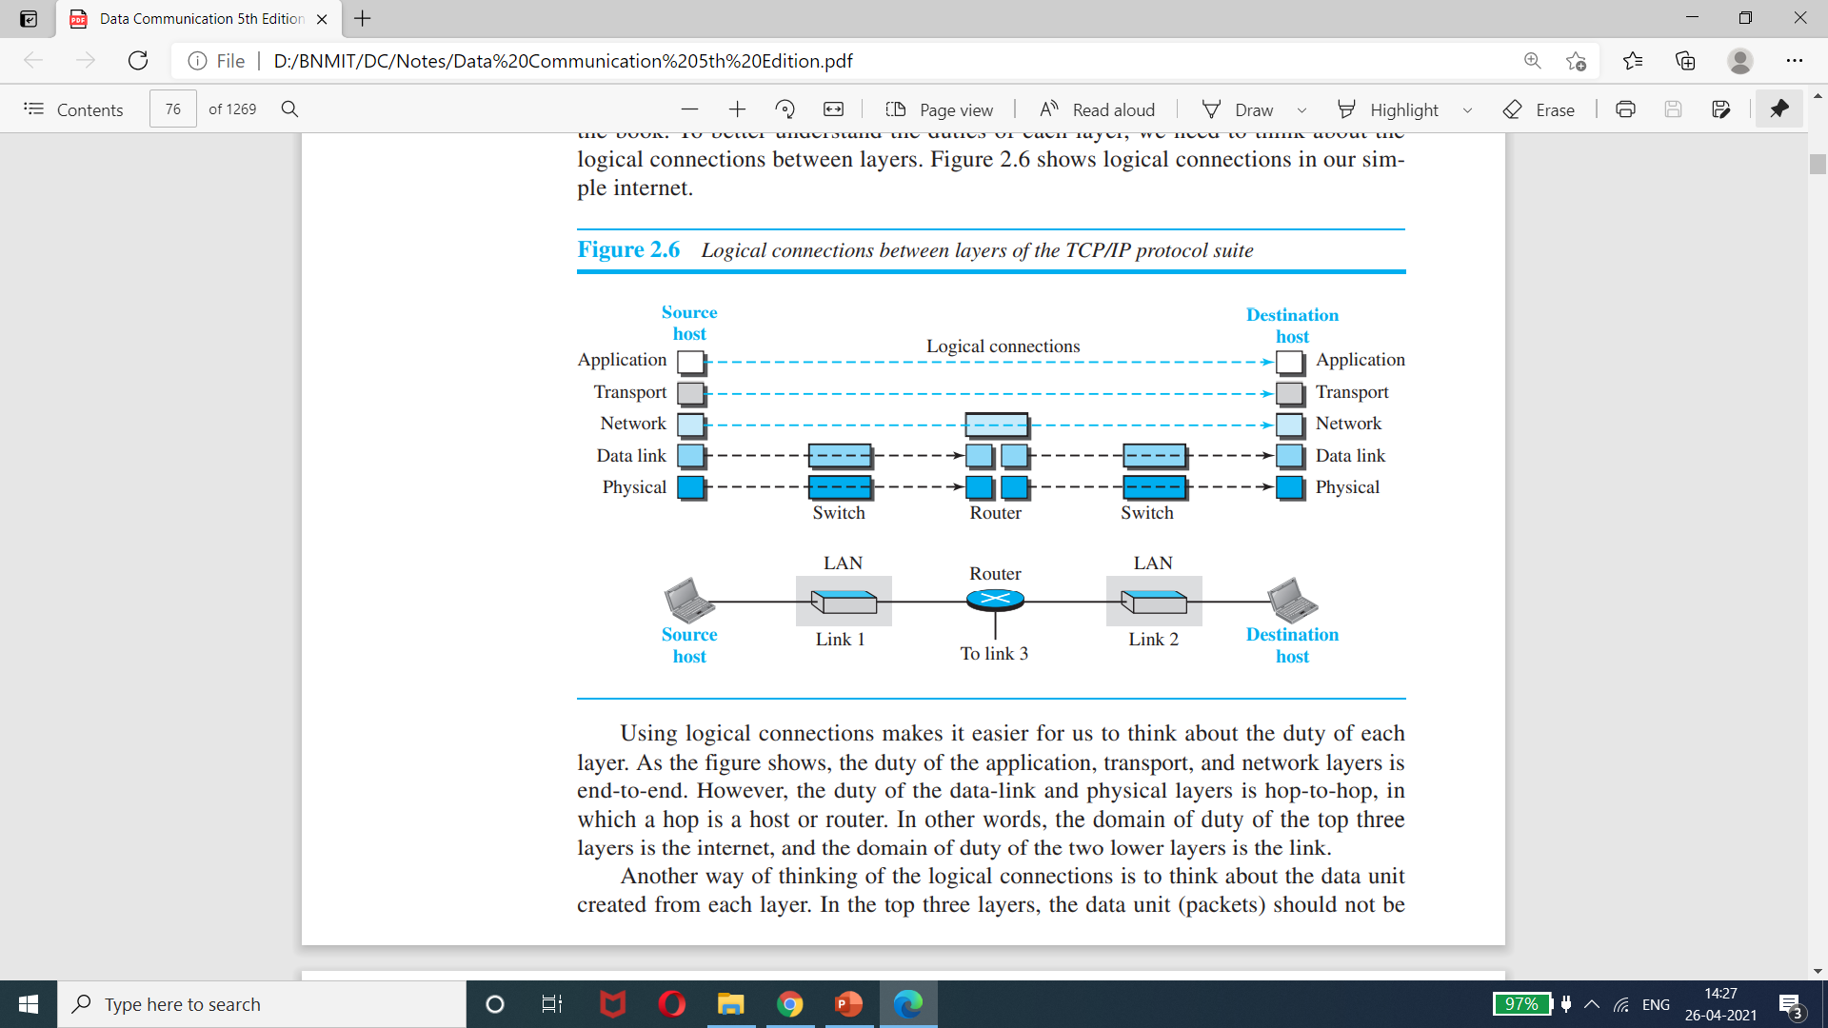
TCP/IP PROTOCOL SUITE
When A wants to talk to B, two switches and a router are involved.
Switches work with two layers.
The same protocol will be maintained on both sides of the switch.
Router works with three layers.
Different pairs (phy/datalink) will be maintained by both sides.
A
B

Slide 71
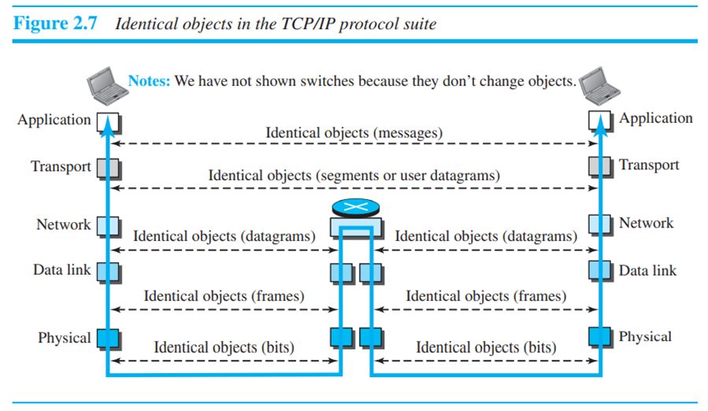
Objects in TCP/IP Protocol Suite

Slide 72
Layers in the TCP/IP Protocol Suite - Description
1. Physical layer (PL)
The lowest level.
PL communication between two devices is still a logical communication.
Hidden layer, the transmission media, under the physical layer.
Transmission medium does not carry bits; it carries electrical or optical signals.
Bits received in a frame from the DLL are transformed and sent through the transmission media, the logical unit between two physical layers in two devices is a bit.
Several protocols are used that transform a bit to a signal

Slide 73
2. Data Link Layer
Multiple links may be available for packets from source to destination.
Routers is responsible to choose the best link.
DLL has the responsibility for taking the datagram and move it across the link.
The link – wired or wireless.
Different protocols are used with different link type.
TCP/IP does not define any specific protocol for the data-link layer.
It supports all the standard and proprietary protocols.
Any protocol that can take the datagram and carry it through the link, and sufficient for the network layer.
DLL takes a datagram and encapsulates it in a packet called a frame.
Some link-layer protocols provide complete error detection and correction, some provide only error correction.

Slide 74
3. Network Layer
Responsible for host-to-host communication and routing the packet through possible routes.
Responsible for creating a connection between the source computer and the destination computer.
Routers in the path are responsible for choosing the best route for each packet.
In internet, NL includes the main protocol, Internet Protocol (IP), that defines the format of the packet, called a datagram at the network layer.
IP also defines the format and the structure of addresses used in this layer.
IP is also responsible for routing a packet from its source to its destination, which is achieved by each router forwarding the datagram to the next router in its path.

Slide 75
IP is a connectionless protocol that provides no flow control, no error control, and no congestion control services.
Includes unicast (one-to-one) and multicast (one-to-many) routing protocols.
IP does routing with the help of a routing protocol that creates forwarding tables.
Other protocols- that help IP in its delivery and routing tasks.
Internet Control Message Protocol (ICMP) helps IP to report some problems when routing a packet.
Internet Group Management Protocol (IGMP) is another protocol that helps IP in multitasking.
Dynamic Host Configuration Protocol (DHCP) helps IP to get the network-layer address for a host.
Address Resolution Protocol (ARP) is a protocol that helps IP to find the link-layer address of a host or a router when its network-layer address is given.

Slide 76
4. Transport Layer
The logical connection at the transport layer is also end-to-end.
Source host TL -gets the message from the application layer(application program), encapsulates it in a transport layer packet (called a segment or a user datagram in different protocols) and sends it, through the logical (imaginary) connection, to the transport layer at the destination host (application program).
More than one protocol in the transport layer- each application program can use the protocol that best matches its requirement.
In Internet, main protocol, Transmission Control Protocol (TCP), is a connection-oriented protocol – Connection establishment, data transfer and connection release.
It creates a logical pipe between two TCPs for transferring a stream of bytes.

Slide 77
Transport Layer Contd..
TCP provides
Flow control
Matching the sending data rate of the source host with the receiving data rate of the destination host to prevent overwhelming the destination
Error control
To guarantee that the segments arrive at the destination without error and resending the corrupted ones
Congestion control
To reduce the loss of segments due to congestion in the network

Slide 78
User Datagram Protocol
A connectionless protocol that transmits user datagrams without first creating a logical connection
each user datagram is an independent entity without being related to the previous or the next one (the meaning of the term connectionless).
A simple protocol that does not provide flow, error, or congestion control.
An application program that needs to send short messages and cannot afford the retransmission of the packets involved in TCP, when a packet is corrupted or lost prefers UDP.
Stream Control Transmission Protocol (SCTP) is designed to respond to new applications that are emerging in the multimedia.

Slide 79
5. Application Layer
The logical connection between the two application layers is end-to-end.
Exchanging of messages done between each other as though there were a bridge between the two layers.
Communication is done through all the layers.
Communication at the application layer is between two processes (two programs running at this layer).
A process sends a request to the other process and receives a response.
Process-to-process communication is the duty of the application layer.

Slide 80
Includes many predefined protocols, but a user can also create a pair of processes to be run at the two hosts.
Hypertext Transfer Protocol (HTTP) - a vehicle for accessing the World Wide Web (WWW).
Simple Mail Transfer Protocol (SMTP) - the main protocol used in electronic mail (e-mail) service.
File Transfer Protocol (FTP) - used for transferring files from one host to another.
Terminal Network (TELNET) and Secure Shell (SSH) - used for accessing a site remotely.
Simple Network Management Protocol (SNMP) - used by an administrator to manage the Internet at global and local levels.
Domain Name System (DNS)-used by other protocols to find the network-layer address of a computer.
Internet Group Management Protocol (IGMP) - used to collect membership in a group.

Slide 81
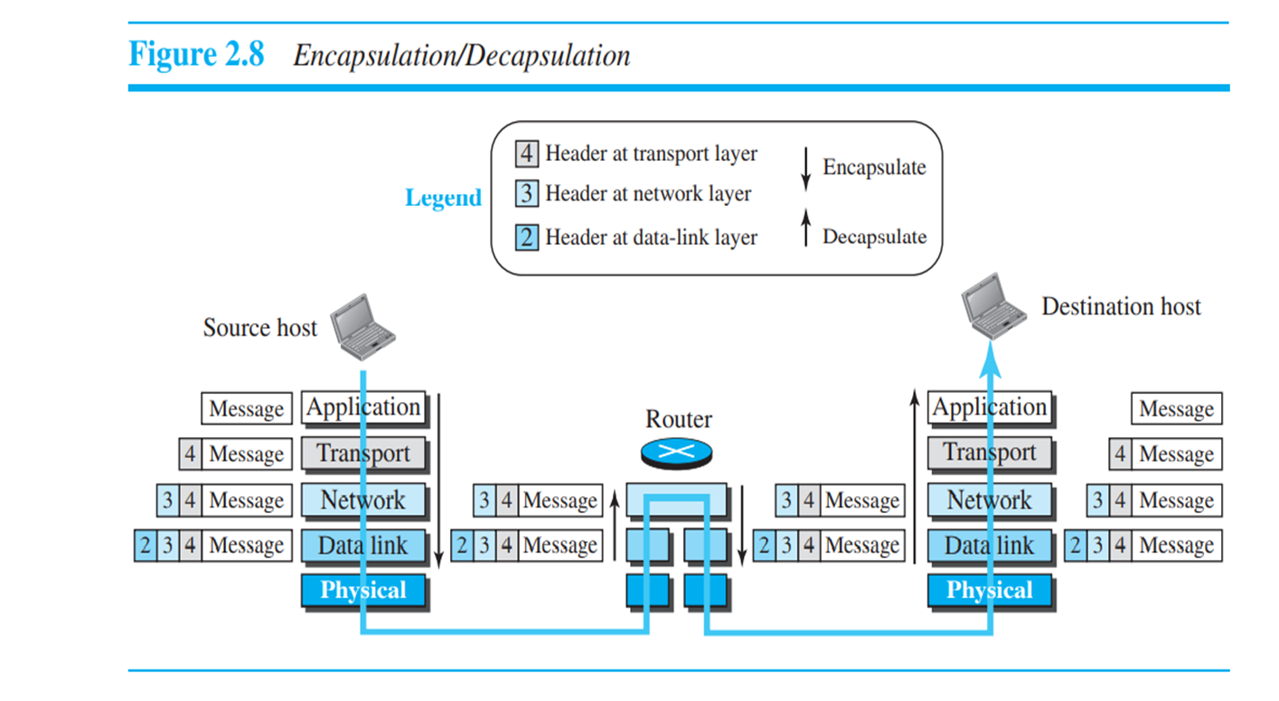
Encapsulation and Decapsulation

Slide 82
Encapsulation at the Source Host
At the source, we have only encapsulation.
1. Application Layer
A message normally does not contain any header or trailer, but if it does, we refer to the whole as the message.
The message is passed to the transport layer.
2. Transport Layer
takes the message as the payload, adds the transport layer header to the payload.
HDR- identifiers of the source and destination application programs + extra info for end-to-end delivery of the message, like information needed for flow, error control, or congestion control.
Result - segment (in TCP) and the user datagram (in UDP).
The transport layer then passes the packet to the network layer.

Slide 83
3. Network Layer
gets payload from TL and adds its own header to payload
HDR – addresses of the source and destination hosts + info on error checking + fragmentation etc.
Result – datagram
NL passes datagram to DLL
4. Data Link Layer
Gets payload from NL and add its own header
HDR- link-layer addresses of the host or the next hop (the router).
Result - frame
DLL passes frames to PL

Slide 84
Encapsulation and Decapsulation
Decapsulation at the Destination Host
each layer only decapsulates the packet received
removes the payload
delivers the payload to the next-higher layer protocol
decapsulation in the host involves error checking

Slide 85
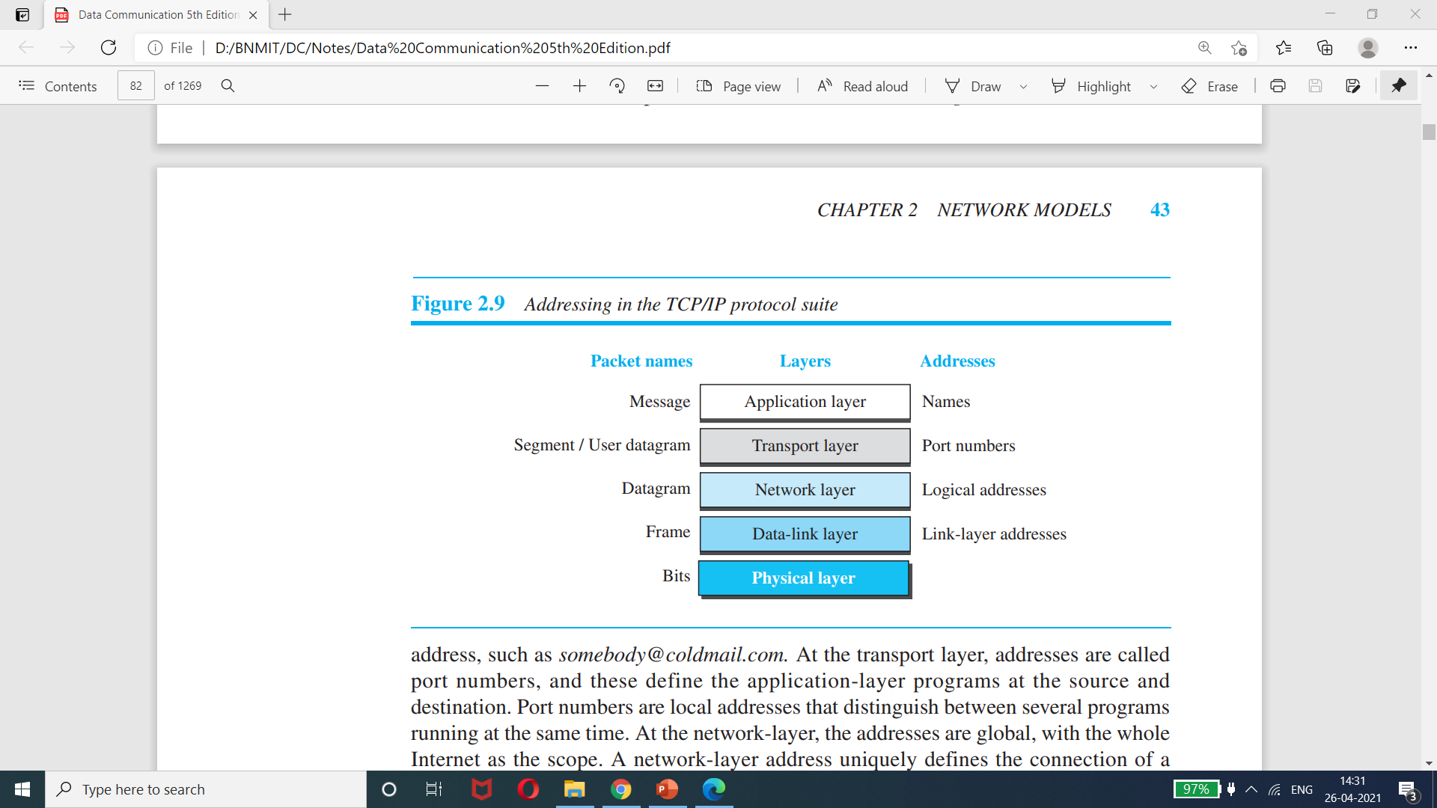
Figure 2.9 Addressing in the TCP/IP protocol suite

Slide 86
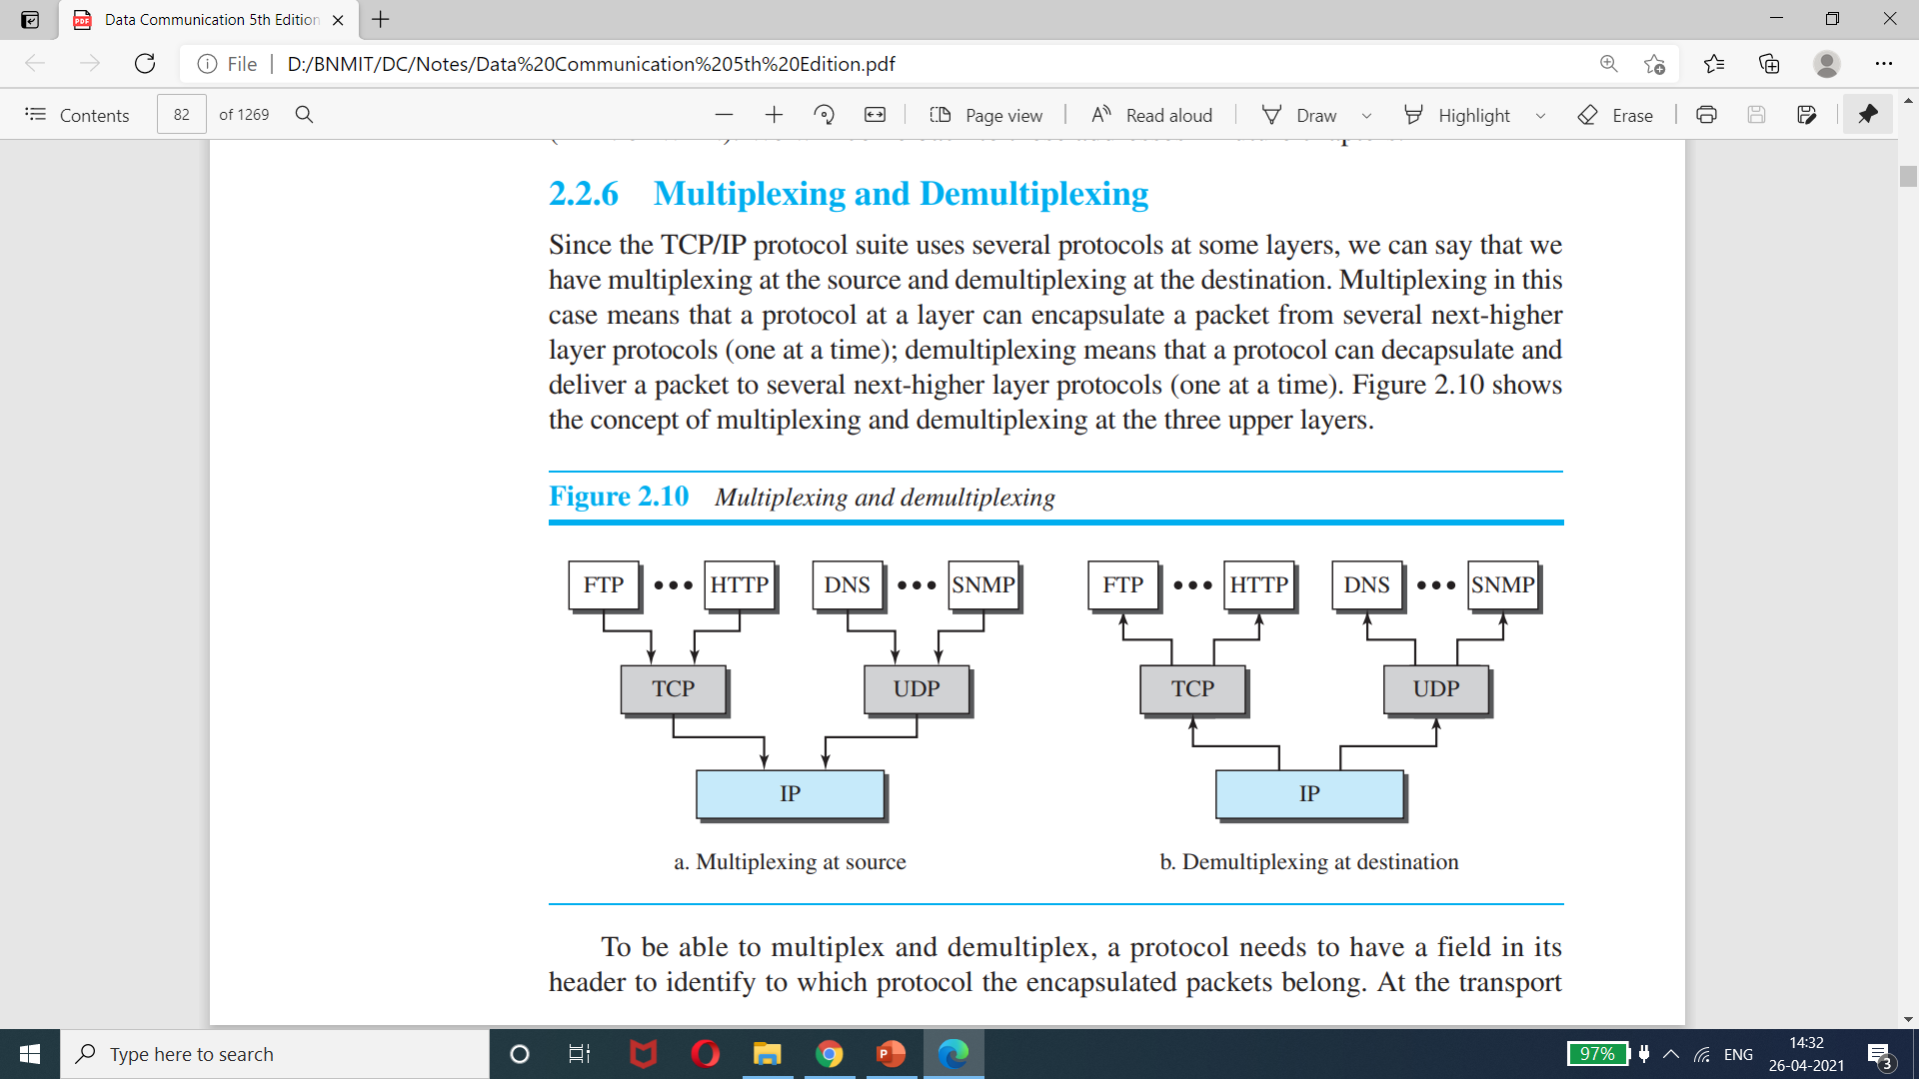
Figure 2.10 Multiplexing and Demultiplexing

Slide 87
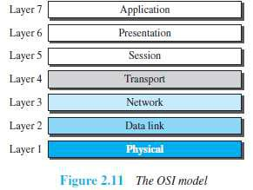
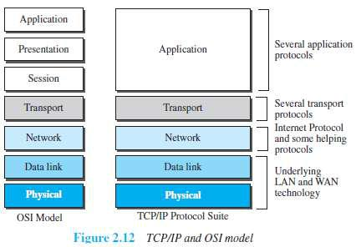
OSI Layer along with TCP/IP

Slide 88
Limitations of OSI layer
OSI was completed when TCP/IP was fully in place and a lot of time and money had been spent on the suite; changing it would cost a lot.
Some layers in the OSI model were never fully defined.
When OSI was implemented by an organization in a different application, it did not show a high enough level of performance

Slide 89
Physical Layer
Major Functionality of PL
to move data in the form of electromagnetic signals across a transmission medium
Transmission media work by conducting energy along a physical path. For transmission, data needs to be changed to signals.

Slide 90
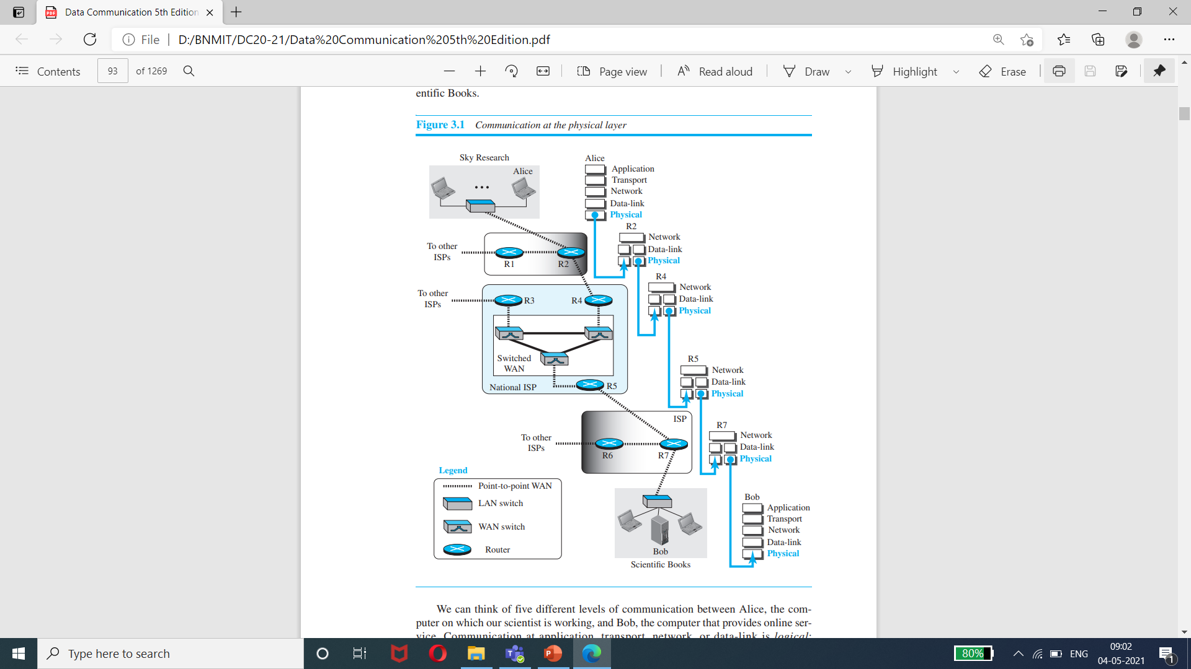
Figure 3.1 Communication at the Physical Layer

Slide 91
ANALOG AND DIGITAL
Data
Can be analog or digital.
Analog data are continuous and take continuous values.
Digital data have discrete states and take discrete values.
Signals
Can be analog or digital.
Analog signals can have an infinite number of values in a range.
Digital signals can have only a limited number of values.

Slide 92
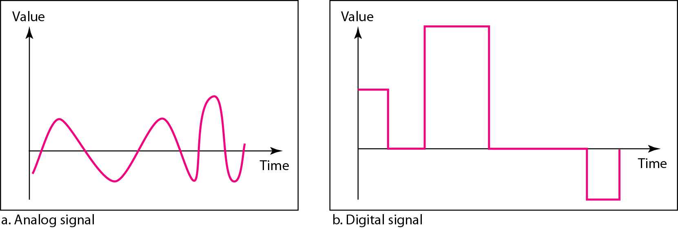
Figure 3.1 Comparison of analog and digital signals

Slide 93
Periodic and Nonperiodic
A periodic signal completes a pattern within a measurable time frame, called a period, and repeats that pattern over subsequent identical periods.
The completion of one full pattern is called a cycle.
A nonperiodic signal changes without exhibiting a pattern or cycle that repeats over time

Slide 94
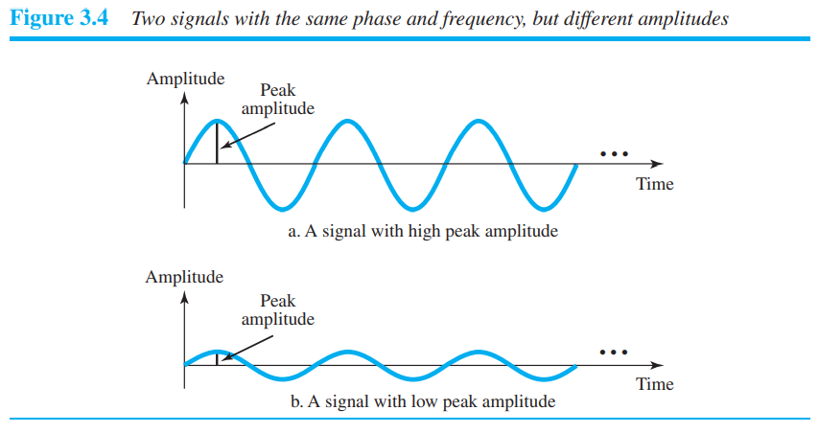
Periodic Analog signal

Slide 95
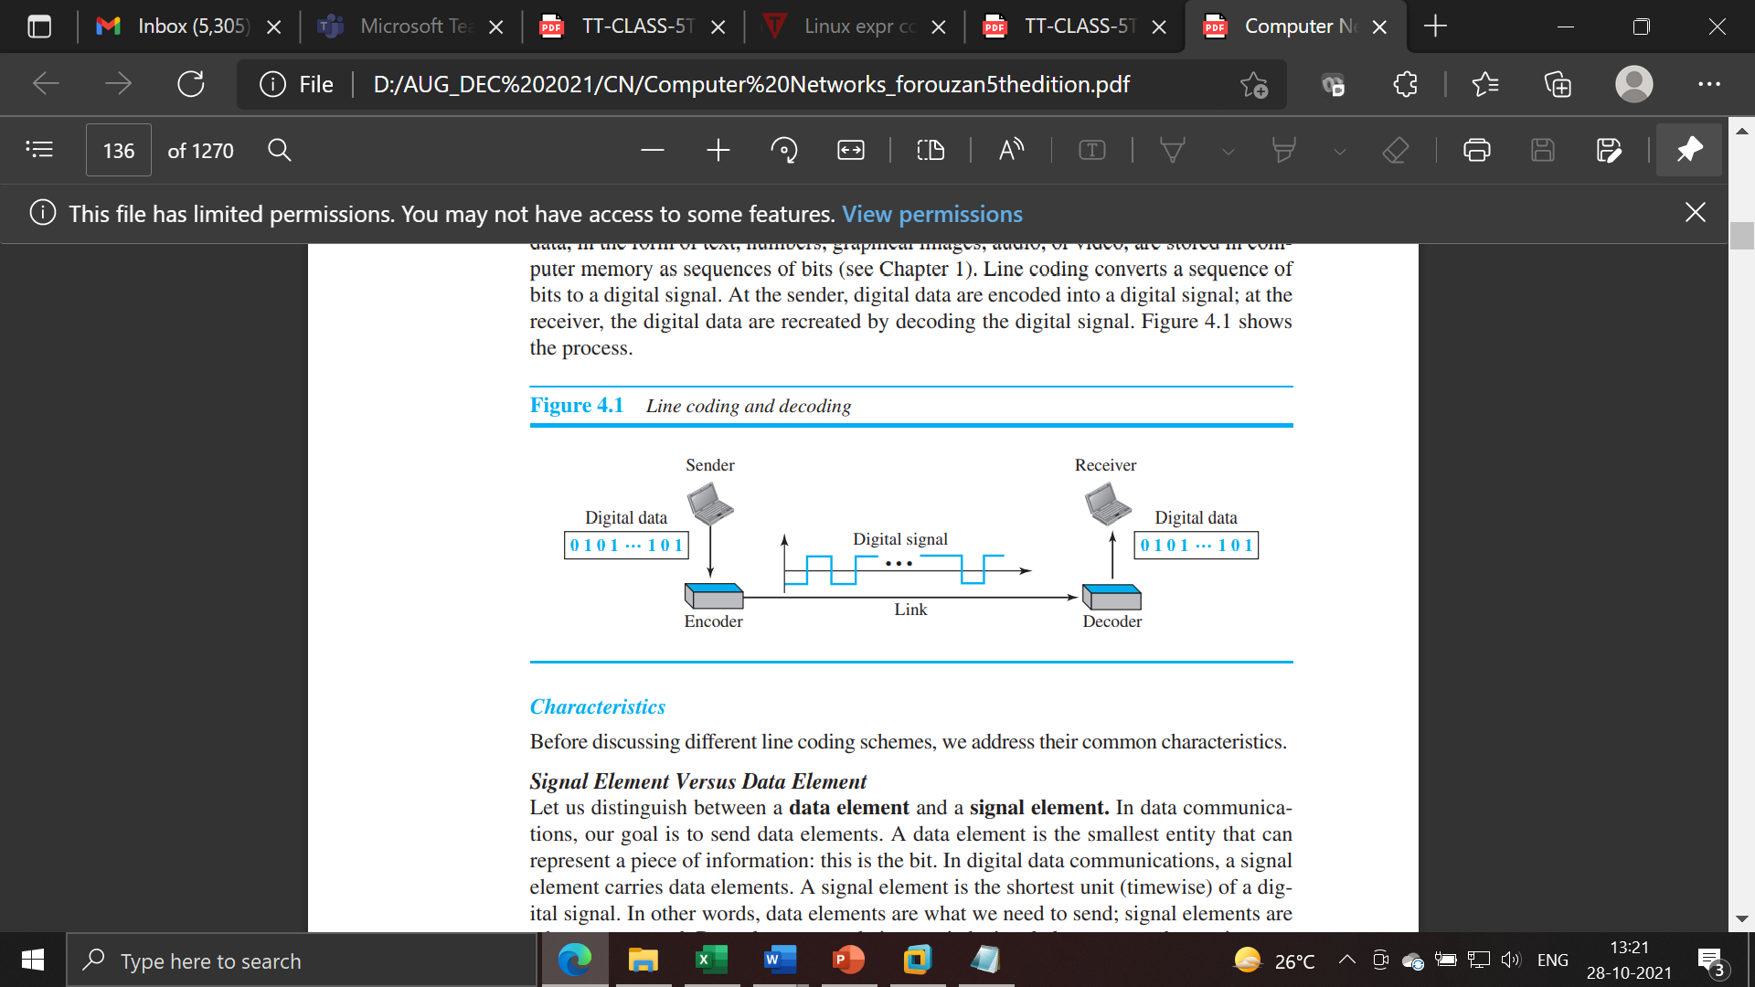

Slide 96
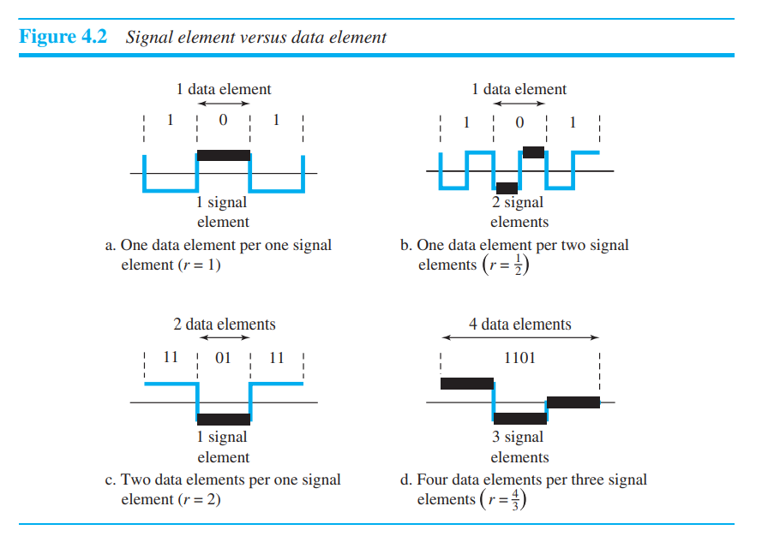

Slide 97
Relationship between data Element and signal Element
A data Element is the smallest entity that can represent a piece of information.
A data element is the bit.
Data elements are being carried
Signal element is shortest unit (time wise) of a digital signal
A Signal elements carries data elements
Signal elements are the carriers

Slide 98
Data rate and Signal rate
Data Rate
It defines the no of data elements(bits) sent in 1 sec.
The unit is bits per sec(bps)
Data rate is also known as bit rate
In the data communication the data rate should increase
Increase of data rate improves the transmission
Signal rate
It defines the no of signal elements sent in 1 sec
The unit is baud
The signal rate is also known as pulse rate, the modulation rate, or the baud rate
The signal rate should decrease
Decreasing the signal rate decreases the bandwidth requirement .

Slide 99
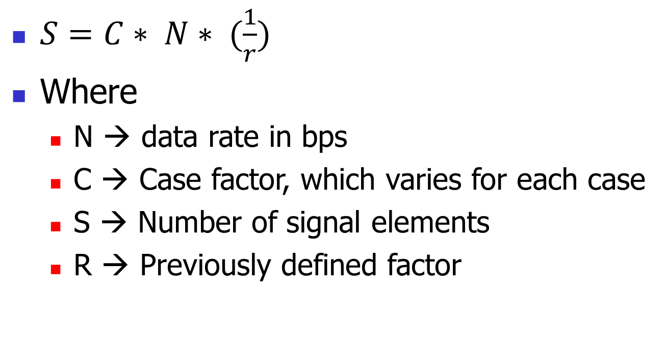
Relationship between Data Rate and Signal Rate

Slide 100
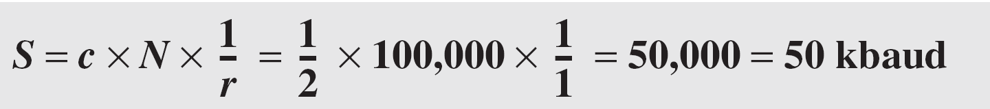
Example 4.1
A signal is carrying data in which one data element is encoded as one signal element. If the bit rate is 100 kbps, what is the average value of the baud rate if c is between 0 and 1?
Solution
We assume that the average value of c is 1/2 . The baud rate is then

Slide 101
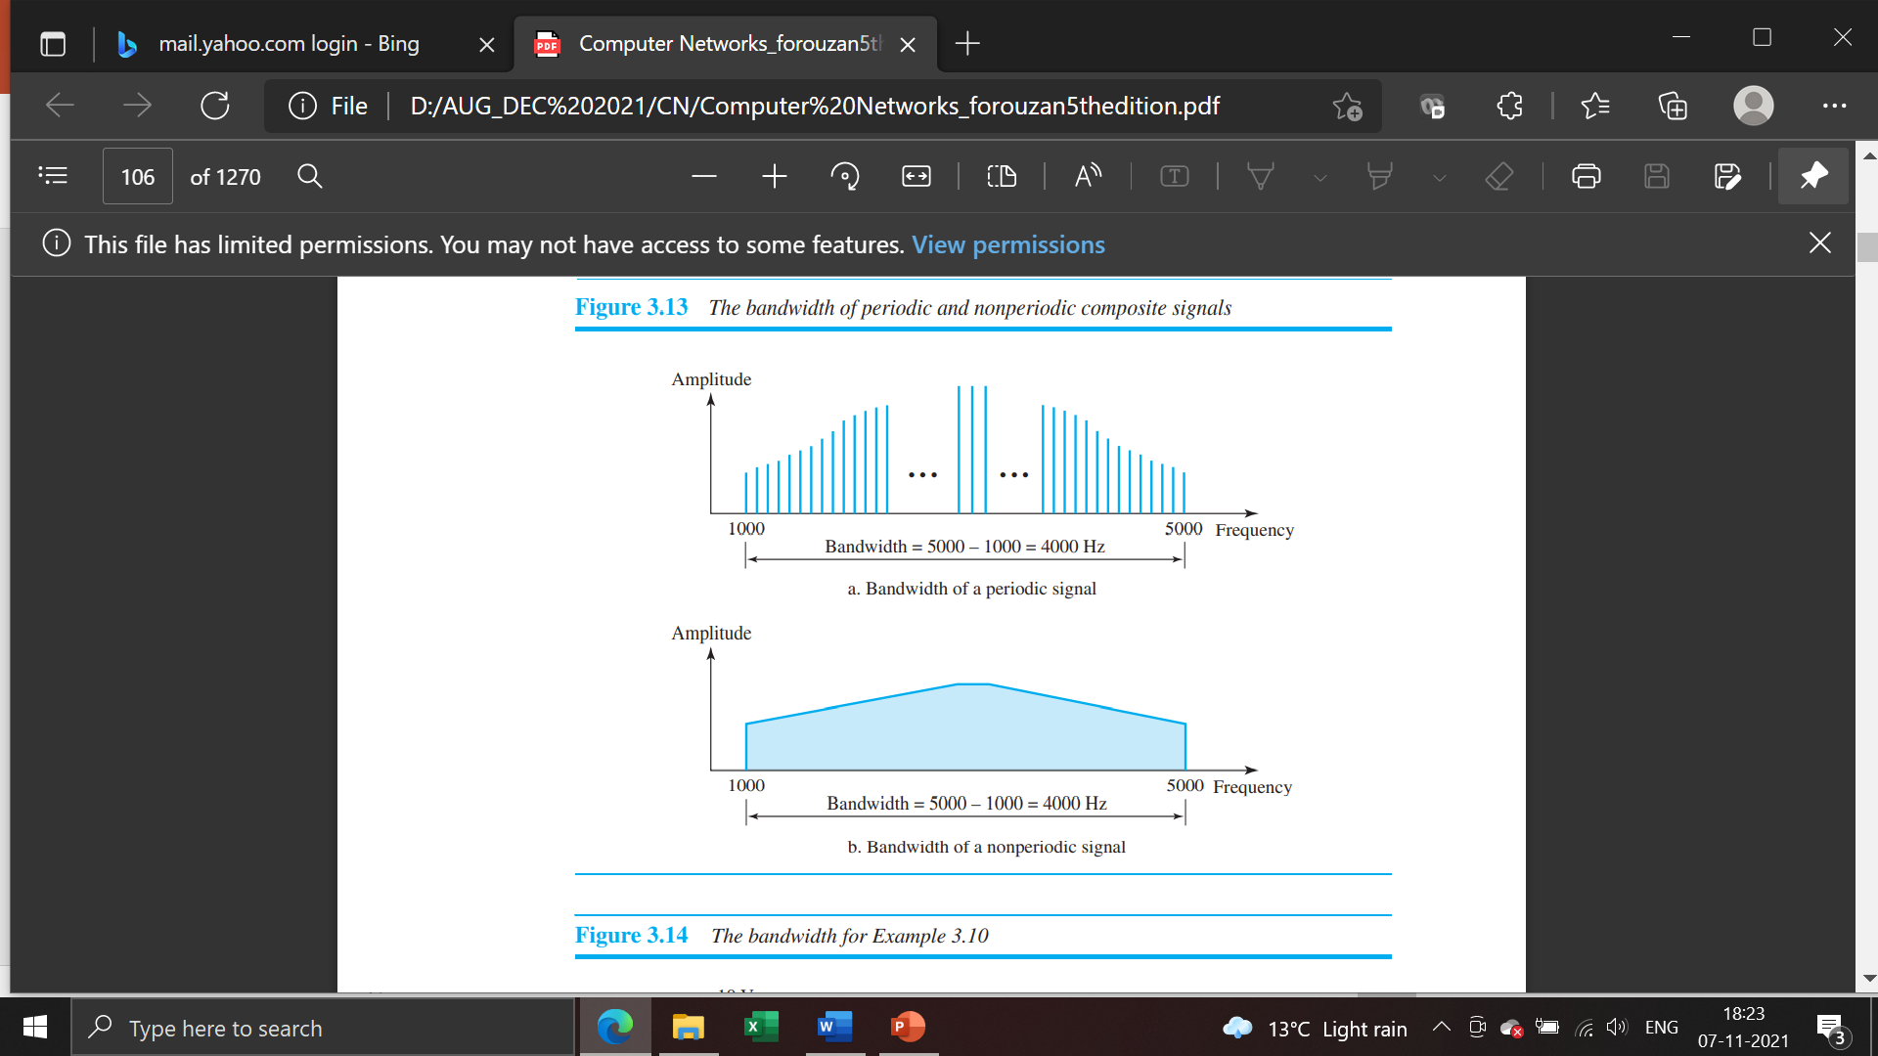
BANDWIDTH-
is the difference between the highest and the lowest frequencies contained in that signal.
is proportional to the signal rate (baud rate).
The minimum bandwidth can be given as
Bmin = c X N X (1 / r)
maximum data rate if the bandwidth of the channel is given.
Nmax = (1 / c) X B X r

Slide 102
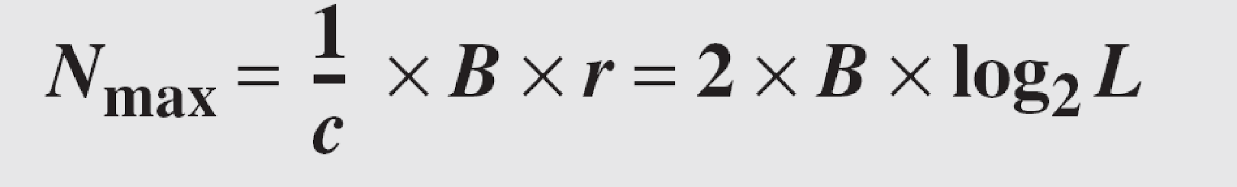
Example 4.2
The maximum data rate of a channel is N_{max} = 2 × B × log₂ L (defined by the Nyquist formula). Does this agree with the previous formula for N_{max}?
Solution
A signal with L levels actually can carry log₂L bits per level. If each level corresponds to one signal element and we assume the average case (c = 1/2), then we have

Slide 103
Baseline wandering
A receiver will evaluate the running average power of the received signal (called the baseline) and use that to determine the value of the incoming data elements.
If the incoming signal does not vary over a long period of time, the baseline will drift and thus cause errors in detection of incoming data elements.
A good line encoding scheme will prevent long runs of fixed amplitude.

Slide 104
DC components
When the voltage level remains constant for long periods of time, there is an increase in the low frequencies of the signal (results of Fourier analysis).
These frequencies around zero are called DC (direct-current) components
They present problems for a system that cannot pass low frequencies or a system that uses electrical coupling (via a transformer).
DC component means 0/1 parity that can cause base-line wondering.
For example, a telephone line cannot pass frequencies below 200 Hz. Also a long-distance link may use one or more transformers to isolate different parts of the line electrically. For these systems, we need a scheme with no DC component.
Most channels are bandpass and may not support the low frequencies.
This will require the removal of the dc component of a transmitted signal.

Slide 105
Self synchronization
The clocks at the sender and the receiver must have the same bit interval.
If the receiver clock is faster or slower it will misinterpret the incoming bit stream.

Slide 106
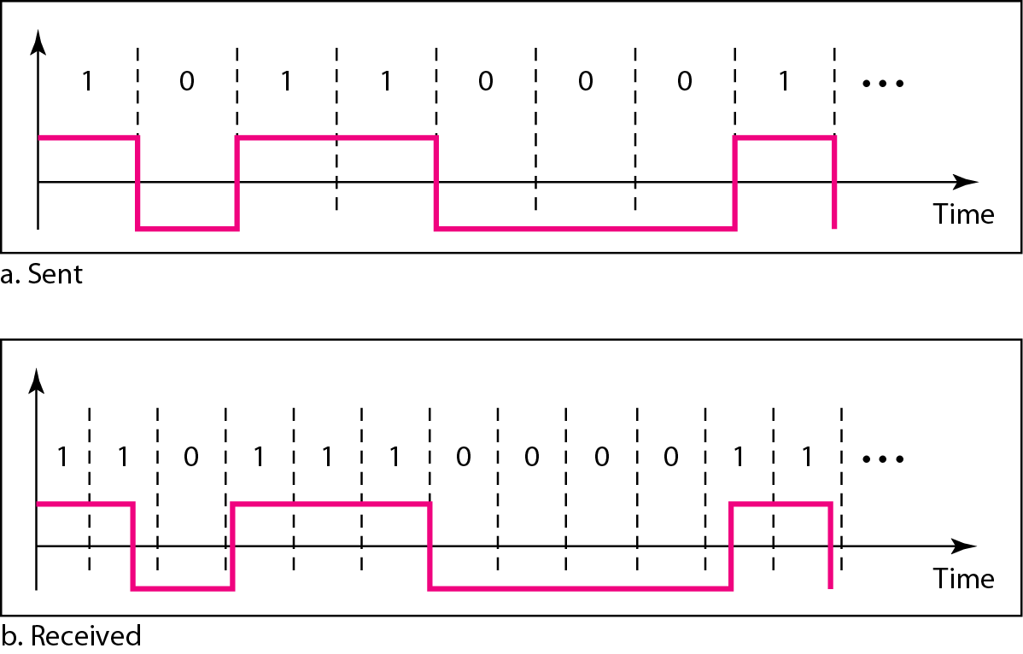
Figure 4.3 Effect of lack of synchronization

Slide 107
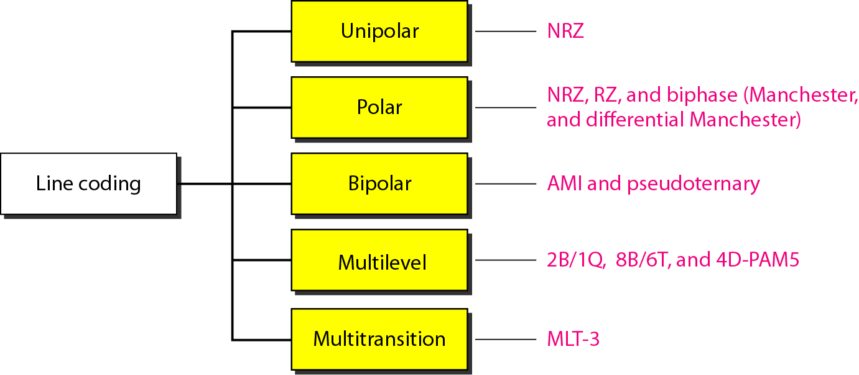
Figure 4.4 Line coding schemes

Slide 108
Unipolar
All signal levels are on one side of the time axis - either above or below
NRZ - Non Return to Zero scheme is an example of this code. The signal level does not return to zero during a symbol transmission (in the middle of the bit).
Scheme is prone to baseline wandering and DC components. It has no synchronization or any error detection. It is simple but costly in power consumption.

Slide 109
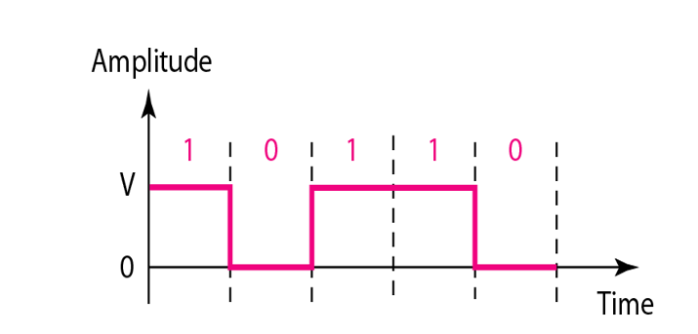
Figure 4.5 Unipolar NRZ scheme

Slide 110
Polar - NRZ
The voltages are on both sides of the time axis.
Polar NRZ scheme can be implemented with two voltages. E.g. +V for 1 and -V for 0.
There are two versions:
NRZ - Level (NRZ-L) - positive voltage for one symbol and negative for the other
NRZ - Inversion (NRZ-I) - the change or lack of change in polarity determines the value of a symbol. E.g. a “1” symbol inverts the polarity a “0” does not.

Slide 111
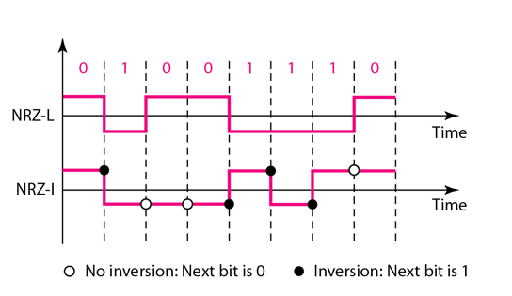
Figure 4.6 Polar NRZ-L and NRZ-I schemes

Slide 112

Note
In NRZ-L the level of the voltage determines the value of the bit. In NRZ-I the inversion or the lack of inversion determines the value of the bit.
NRZ-L and NRZ-I both have an average signal rate of N/2 Bd.

Slide 113
Note
NRZ-L and NRZ-I both have a DC component problem and baseline wandering, it is worse for NRZ-L. Both have no self synchronization &no error detection. Both are relatively simple to implement.

Slide 114
Example 4.4
A system is using NRZ-I to transfer 1-Mbps data. What are the average signal rate and minimum bandwidth?
Solution
The average signal rate is S= c x N x R = 1/2 x N x 1 = 500 kbaud. The minimum bandwidth for this average baud rate is B_{min} = S = 500 kHz.
Note c = 1/2 for the avg. case as worst case is 1 and best case is 0

Slide 115
Polar - RZ
The Return to Zero (RZ) scheme uses three voltage values. +, 0, -.
Each bit has a transition in the middle. Either from high to zero or from low to zero.
This scheme has more signal transitions (two per bit) and therefore requires a wider bandwidth.
Self synchronization - transition indicates bit value.
More complex as it uses three voltage level. It has no error detection capability.

Slide 116
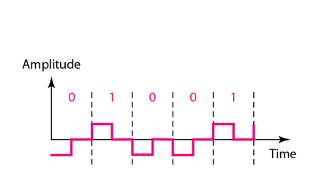
Figure 4.7 Polar RZ scheme

Slide 117
Polar - Biphase: Manchester and Differential Manchester
Manchester coding is a combination of NRZ-L and RZ schemes.
Every bit has a level transition in the middle: from high to low or low to high. Uses only two voltage levels.
Differential Manchester is a combination of the NRZ-I and RZ schemes.
Every bit has a level transition in the middle. But the level at the beginning of the symbol is determined by the symbol value. One symbol causes a level change the other does not.

Slide 118
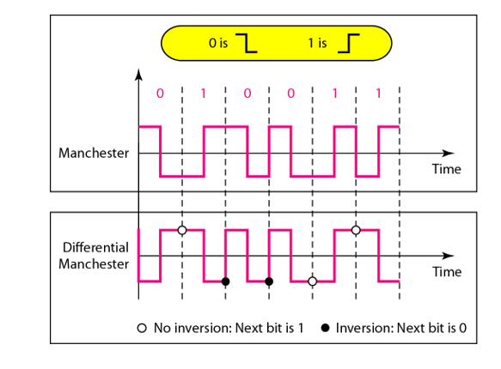
Figure 4.8 Polar biphase: Manchester and differential Manchester schemes

Slide 119
Note
In Manchester and differential Manchester encoding, the transition
at the middle of the bit is used for synchronization.
Minimum bandwidth required is 2 times that of NRZ

Slide 120
Bipolar - AMI and Pseudo-ternary
Code uses 3 voltage levels: - +, 0, -, to represent the bits (no transitions to zero as in RZ).
Voltage level for one symbol is at “0” and the other alternates between + & -.
Bipolar Alternate Mark Inversion (AMI) - the “0” symbol is represented by zero voltage and the “1” symbol alternates between +V and -V.
Pseudo-ternary is the reverse of AMI.

Slide 121
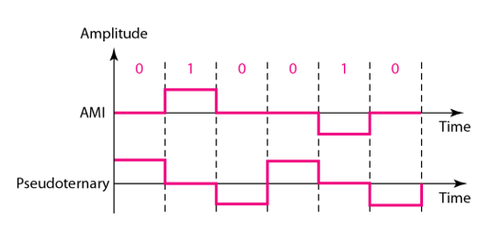
Figure 4.9 Bipolar schemes: AMI and pseudoternary

Slide 122
Bipolar Characteristics
It is a better alternative to NRZ.
Has no DC component or baseline wandering.
Has no self synchronization because long runs of “0”s results in no signal transitions.
No error detection.

Slide 123
Multilevel Schemes
In these schemes we increase the number of data bits per signal thereby increasing the bit rate.
Since we are dealing with binary data we only have 2 types of data element a 1 or a 0.
We can combine the 2 data elements into a pattern of “m” elements to create “2^{m}” symbols.
If we have L signal levels, we can use “n” signal elements to create L^{n} signal elements.

Slide 124
Code Characteristics
Now we have 2^{m} symbols and L^{n} signals.
If 2^{m} > L^{n} then we cannot represent the data elements, we don’t have enough signals.
If 2^{m} = L^{n} then we have an exact mapping of one symbol on one signal.
If 2^{m} < L^{n} then we have more signals than symbols and we can choose the signals that are more distinct to represent the symbols and therefore have better noise immunity and error detection as some signals are not valid.

Slide 125
Note
In mBnL schemes, a pattern of m data elements is encoded as a pattern of n signal elements in which 2^{m} ≤ L^{n}.

Slide 126

Representing Multilevel Codes
We use the notation mBnL, where m is the length of the binary pattern, B represents binary data, n represents the length of the signal pattern and L the number of levels.

Slide 127


Figure 4.10 Multilevel: 2B1Q scheme

Slide 128

Multilevel: 8B6T scheme

Slide 129


Slide 130
Multilevel using multiple channels
In some cases, we split the signal transmission up and distribute it over several links.
The separate segments are transmitted simultaneously. This reduces the signal rate per link -> lower bandwidth.
This requires all bits for a code to be stored.
xD: means that we use ‘x’ links
YYYz: We use ‘z’ levels of modulation where YYY represents the type of modulation (e.g. pulse ampl. mod. PAM).
Codes are represented as: xD-YYYz

Slide 131

Figure 4.12 Multilevel: 4D-PAM5 scheme

Slide 132
Multi-transition Coding
Because of synchronization requirements we force more transitions. This can result in very high bandwidth requirements -> more transitions than are bits (e.g. mid bit transition with inversion).
Codes can be created that are differential at the bit level forcing transitions at bit boundaries. This results in a bandwidth requirement that is equivalent to the bit rate.
In some instances, the bandwidth requirement may even be lower, due to repetitive patterns resulting in a periodic signal.

Slide 133

Multitransition: MLT-3 scheme

Slide 134
MLT-3- Multiline Transmission, 3 levels
Signal rate is same as NRZ-I
But because of the resulting bit pattern, we have a periodic signal for worst case bit pattern: 1111
This can be approximated as an analog signal a frequency 1/4 the bit rate!

Slide 135


Table 4.1 Summary of line coding schemes

Slide 136
Convert the below bit pattern into digital signal using all the known line coding schemes.
0110100101100110

Slide 137
Block Coding
For a code to be capable of error detection, we need to add redundancy, i.e., extra bits to the data bits.
Synchronization also requires redundancy - transitions are important in the signal flow and must occur frequently.
Block coding is done in three steps: division, substitution and combination.
It is represented by - xB/yB.
The resulting bit stream prevents certain bit combinations that when used with line encoding would result in DC components or poor sync. quality.

Slide 138
Note
Block coding is normally referred to as mB/nB coding;
it replaces each m-bit group with an n-bit group.

Slide 139

Figure 4.14 Block coding concept

Slide 140

Figure 4.15 Using block coding 4B/5B with NRZ-I line coding scheme
OBJECTIVE:
For error detection and synchronization, redundancy is introduced
NRZ-I – Sequence of 0s are cut with the rule with leading zeros are not more than one and trailing zeros not more than two

Slide 141


Table 4.2 4B/5B mapping codes

Slide 142

Figure 4.16 Substitution in 4B/5B block coding

Slide 143
Redundancy
A 4 bit data word can have 2⁴ combinations.
A 5 bit word can have 2⁵=32 combinations.
We therefore have 32 - 26 = 16 extra words.
Some of the extra words are used for control/signalling purposes.

Slide 144
Example 4.5
We need to send data at a 1-Mbps rate. What is the minimum required bandwidth, using a combination of 4B/5B and NRZ-I or Manchester coding?
Solution
First 4B/5B block coding increases the bit rate to 1.25 Mbps. The minimum bandwidth using NRZ-I is N/2 or 625 kHz. The Manchester scheme needs a minimum bandwidth of 1.25 MHz. The first choice needs a lower bandwidth, but has a DC component problem; the second choice needs a higher bandwidth, but does not have a DC component problem.

Slide 145

Figure 4.17 8B/10B block encoding

Slide 146
More bits - better error detection
The 8B/10B block code adds more redundant bits and can thereby choose code words that would prevent a long run of a voltage level that would cause DC components.

Slide 147
Scrambling
The best code is one that does not increase the bandwidth for synchronization and has no DC components.
Scrambling is a technique used to create a sequence of bits that has the required characteristics for transmission - self clocking, no low frequencies, no wide bandwidth.
It is implemented at the same time as encoding, the bit stream is created on the fly.
It replaces ‘unfriendly’ runs of bits with a violation code that is easy to recognize and removes the unfriendly transmission characteristics.

Slide 148

Figure 4.18 AMI used with scrambling

Slide 149
For example: B8ZS substitutes eight consecutive zeros with 000VB0VB.
The V stands for violation, it violates the line encoding rule
B stands for bipolar, it implements the bipolar line encoding rule

Slide 150

Figure 4.19 Two cases of B8ZS scrambling technique

Slide 151
HDB3 substitutes four consecutive zeros with 000V or B00V depending
on the number of nonzero pulses after the last substitution.
If # of non zero pulses is even the substitution is B00V to make total # of non zero pulse even.
If # of non zero pulses is odd the substitution is 000V to make total # of non zero pulses even.

Slide 152

Figure 4.20 Different situations in HDB3 scrambling technique

Slide 153
Chapter 6
Bandwidth Utilization:
Multiplexing and Spreading

Slide 154
Note
Bandwidth utilization is the wise use of available bandwidth to achieve specific goals.
Efficiency can be achieved by multiplexing; i.e., sharing of the bandwidth between multiple users.

Slide 155
6-1 MULTIPLEXING
Whenever the bandwidth of a medium linking two devices is greater than the bandwidth needs of the devices, the link can be shared. Multiplexing is the set of techniques that allows the (simultaneous) transmission of multiple signals across a single data link. As data and telecommunications use increases, so does traffic.
Topics discussed in this section:
Frequency-Division Multiplexing
Wavelength-Division Multiplexing
Synchronous Time-Division Multiplexing
Statistical Time-Division Multiplexing

Slide 156

Figure 6.1 Dividing a link into channels

Slide 157

Figure 6.2 Categories of multiplexing

Slide 158

Figure 6.3 Frequency-division multiplexing (FDM)

Slide 159
Note
FDM is an analog multiplexing technique that combines analog signals.
It uses the concept of modulation.

Slide 160
Modulation: Modulation is the process of overlaying a message signal on a carrier signal to enable long-distance message transmission. The high frequency signal used to carry the message signal in this case is known as the carrier signal.
Demodulation: Demodulation is the process of extracting the original message from a modulated signal. Demodulation is the process of separating a message signal from a carrier signal.

Slide 161

Figure 6.4 FDM process

Slide 162

Figure 6.5 FDM demultiplexing example

Slide 163
Example 6.1
Assume that a voice channel occupies a bandwidth of 4 kHz. We need to combine three voice channels into a link with a bandwidth of 12 kHz, from 20 to 32 kHz. Show the configuration, using the frequency domain. Assume there are no guard bands.
Solution
We shift (modulate) each of the three voice channels to a different bandwidth, as shown in Figure 6.6. We use the 20- to 24-kHz bandwidth for the first channel, the 24- to 28-kHz bandwidth for the second channel, and the 28- to 32-kHz bandwidth for the third one. Then we combine them as shown in Figure 6.6.

Slide 164

Figure 6.6 Example 6.1

Slide 165
Example 6.2
Five channels, each with a 100-kHz bandwidth, are to be multiplexed together. What is the minimum bandwidth of the link if there is a need for a guard band of 10 kHz between the channels to prevent interference?
Solution
For five channels, we need at least four guard bands. This means that the required bandwidth is at least
5 × 100 + 4 × 10 = 540 kHz,
as shown in Figure 6.7.

Slide 166

Figure 6.7 Example 6.2

Slide 167

Figure 6.9 Analog hierarchy

Slide 168
Other Applications of FDM
A very common application of FDM is AM and FM radio broadcasting.
Radio uses the air as the transmission medium.
A special band from 530 to 1700 kHz is assigned to AM radio.
All radio stations need to share this band.
Each AM station needs 10 kHz of bandwidth.
Without multiplexing, only one AM station could broadcast to the common link, the air.
FM has a wider band of 88 to 108 MHz because each station needs a bandwidth of 200 kHz. Television broadcasting.
Each TV channel has its own bandwidth.

Slide 169
Implementation
For cases, such as radio and television broadcasting, there is no need for a physical multiplexer or demultiplexer. As long as the stations agree to send their broadcasts to the air using different carrier frequencies, multiplexing is achieved.
In other cases, such as the cellular telephone system, a base station needs to assign a carrier frequency to the telephone user. There is not enough bandwidth in a cell to permanently assign a bandwidth range to every telephone user. When a user hangs up, her or his bandwidth is assigned to another caller.

Slide 170
Example 6.4
The Advanced Mobile Phone System (AMPS) uses two bands. The first band of 824 to 849 MHz is used for sending, and 869 to 894 MHz is used for receiving. Each user has a bandwidth of 30 kHz in each direction. How many people can use their cellular phones simultaneously?
Solution
Each band is 25 MHz. If we divide 25 MHz by 30 kHz, we get 833.33. In reality, the band is divided into 832 channels. Of these, 42 channels are used for control, which means only 790 channels are available for cellular phone users.

Slide 171

Figure 6.10 Wavelength-division multiplexing (WDM)
Wavelength-division multiplexing (WDM) is designed to use the high-data-rate capability of fiber-optic cable.
The optical fiber data rate is higher than the data rate of metallic transmission cable,
but using a fiber-optic cable for a single line wastes the available bandwidth.

Slide 172
Note
WDM is an analog multiplexing technique to combine optical signals.

Slide 173

Figure 6.11 Prisms in wavelength-division multiplexing and demultiplexing
Achieved by varying the angle of incidence and frequency
Very narrow bands of light from different sources are combined to make a wider band of light. At the receiver, the signals are separated by the demultiplexer.

Slide 174

Time Division Multiplexing
Time division multiplexing is a digital process that allows several connections to share a high bandwidth link.
Instead of sharing the bandwidth, time is shared.

Slide 175
Note
TDM is a digital multiplexing technique for combining several low-rate digital channels into one high-rate one.

Slide 176

Synchronous time-division multiplexing
Time Slots and Frames: The data flow of each input connection is divided into units, each occupies one input time slot.
After multiplexing each input unit becomes an output unit and occupies one output time slot.
If input time slot is T s, output time slot is T/n s.

Slide 177
Frames: The data inputs from each connection is collected into a frame. If we have n connections, there will be n slots in the frame.
The data rate of the output link must be n times the data rate of the input connection to ensure guaranteed flow of data.

Slide 178
Note
In synchronous TDM, the data rate of the link is n times faster, and the unit duration is n times shorter.

Slide 179
Example 6.5
In Figure 6.13, the data rate for each one of the 3 input connection is 1 kbps. If 1 bit at a time is multiplexed (a unit is 1 bit), what is the duration of (a) each input slot, (b) each output slot, and (c) each frame?
Solution
We can answer the questions as follows:
a. The data rate of each input connection is 1 kbps. This means that the bit duration is 1/1000 s or 1 ms. The duration of the input time slot is 1 ms (same as bit duration).

Slide 180
Example 6.5 (continued)
b. The duration of each output time slot is one-third of the input time slot. This means that the duration of the output time slot is 1/3 ms.
c. Each frame carries three output time slots. So the duration of a frame is 3 × 1/3 ms, or 1 ms.
Note: The duration of a frame is the same as the duration of an input unit.

Slide 181
Example 6.6
Figure 6.14 shows synchronous TDM with 4 1Mbps data stream inputs and one data stream for the output. The unit of data is 1 bit. Find (a) the input bit duration, (b) the output bit duration, (c) the output bit rate, and (d) the output frame rate.
Solution
We can answer the questions as follows:
a. The input bit duration is the inverse of the bit rate: 1/1 Mbps = 1 μs.
b. The output bit duration is one-fourth of the input bit duration, or ¼ μs.

Slide 182
Example 6.6 (continued)
c. The output bit rate is the inverse of the output bit duration or 1/(4μs) or 4 Mbps. This can also be deduced from the fact that the output rate is 4 times as fast as any input rate; so the output rate = 4 × 1 Mbps = 4 Mbps.
d. The frame rate is always the same as any input rate. So the frame rate is 1,000,000 frames per second. Because we are sending 4 bits in each frame, we can verify the result of the previous question by multiplying the frame rate by the number of bits per frame.

Slide 183

Figure 6.14 Refer this figure for Example 6.6

Slide 184

Interleaving
The process of taking a group of bits from each input line for multiplexing is called interleaving.
We interleave bits from each input onto one output.

Slide 185
Example 6.8
Four channels are multiplexed using TDM. If each channel sends 100 bytes /s and we multiplex 1 byte per channel, show the frame traveling on the link, the size of the frame, the duration of a frame, the frame rate, and the bit rate for the link.
Solution
Each frame carries 1 byte from each channel; the size of each frame, therefore, is 4 bytes, or 32 bits. Because each channel is sending 100 bytes/s and a frame carries 1 byte from each channel, the frame rate must be 100 frames per second. The bit rate is 100 × 32, or 3200 bps.

Slide 186

Figure 6.16 Example 6.8

Slide 187
Example 6.9
A multiplexer combines four 100-kbps channels using a time slot of 2 bits. Show the output with four arbitrary inputs. What is the frame rate? What is the frame duration? What is the bit rate? What is the bit duration?
Solution
Figure 6.17 shows the output (4x100kbps) for four arbitrary inputs. The link carries 400K/(2x4)=50,000 2x4=8bit frames per second. The frame duration is therefore 1/50,000 s or 20 μs. The bit duration on the output link is 1/400,000 s, or 2.5 μs.

Slide 188

Figure 6.17 Example 6.9

Slide 189
Data Rate Management
Not all input links maybe have the same data rate.
Some links maybe slower. There maybe several different input link speeds
There are three strategies that can be used to overcome the data rate mismatch: multilevel, multi-slot and pulse stuffing.

Slide 190
Multilevel Multiplexing
Multilevel multiplexing is a technique used when the data rate of an input line is a multiple of others.
For example, we have two inputs of 20 kbps and three inputs of 40 kbps.
The first two input lines can be multiplexed together to provide a data rate equal to the last three.
A second level of multiplexing can create an output of 160 kbps.

Slide 191

Figure 6.19 Multilevel multiplexing

Slide 192
Multiple-Slot Allocation
Sometimes it is more efficient to allot more than one slot in a frame to a single input line.
For example, we might have an input line that has a data rate that is a multiple of another input.
We insert a de-multiplexer in the line to make two inputs out of one.

Slide 193

Figure 6.20 Multiple-slot multiplexing

Slide 194

Figure 6.21 Pulse stuffing
Sometimes the bit rates of sources are not multiple integers of each other. Therefore, neither of the above two techniques can be applied.
One solution is to make the highest input data rate the dominant data rate and then add dummy bits to the input lines with lower rates. This will increase their rates.
This technique is called pulse stuffing, bit padding, or bit stuffing.

Slide 195

Synchronization
The implementation of TDM is not as simple as that of FDM.
Synchronization between the multiplexer and demultiplexer is a major issue.
If the multiplexer and the de-multiplexer are not synchronized, a bit belonging to one channel may be received by the wrong channel.
For this reason, one or more synchronization bits are usually added to the beginning and end of each frame.
These bits, called framing bits, follow a pattern, frame to frame, that allows the de-multiplexer to synchronize with the incoming stream so that it can separate the time slots accurately.
In most cases, this synchronization information consists of 1 bit per frame, alternating between 0 and 1 .

Slide 196
Example 6.10
We have four sources, each creating 250 8-bit characters per second. If the interleaved unit is a character and 1 synchronizing bit is added to each frame, find (a) the data rate of each source, (b) the duration of each character in each source, (c) the frame rate, (d) the duration of each frame, (e) the number of bits in each frame, and (f) the data rate of the link.
Solution
We can answer the questions as follows:
a. The data rate of each source is 250 × 8 = 2000 bps = 2 kbps.

Slide 197
Example 6.10 (continued)
b. Each source sends 250 characters per second; therefore, the duration of a character is 1/250 s, or 4 ms.
c. Each frame has one character from each source, which means the link needs to send 250 frames per second to keep the transmission rate of each source.
d. The duration of each frame is 1/250 s, or 4 ms. Note that the duration of each frame is the same as the duration of each character coming from each source.
e. Each frame carries 4 characters and 1 extra synchronizing bit. This means that each frame is 4 × 8 + 1 = 33 bits.

Slide 198
Inefficient use of Bandwidth
Sometimes an input link may have no data to transmit.
When that happens, one or more slots on the output link will go unused.
That is wasting the bandwidth.

Slide 199

Figure 6.18 Empty slots

Slide 200
Statistical Time-Division Multiplexing
As we saw in the previous section, in synchronous TDM, each input has a reserved slot in the output frame.
This can be inefficient if some input lines have no data to send.
In statistical time-division multiplexing, slots are dynamically allocated to improve bandwidth efficiency.
Figure 6.26 shows a synchronous and a statistical TDM example.

Slide 201

Figure 6.26 TDM slot comparison

Slide 202
Definitions
Addressing
In synchronous TDM, there is no need for addressing; synchronization and pre-assigned relationships between the inputs and outputs serve as an address. In statistical multiplexing, there is no fixed relationship between the inputs and outputs because there are no pre-assigned or reserved slots. The addressing in its simplest form can be n bits to define N different output lines with n = log2 N. For example, for eight different output lines, we need a 3-bit address.

Slide 203
Definitions
Slot Size
Since a slot carries both data and an address in statistical TDM, the ratio of the data size to address size must be reasonable to make transmission efficient. For example, it would be inefficient to send 1 bit per slot as data when the address is 3 bits. This would mean an overhead of 300 percent. In statistical TDM, a block of data is usually many bytes while the address is just a few bytes.

Slide 204
Definitions
No Synchronization Bit There is another difference between synchronous and statistical TDM, but this time it is at the frame level. The frames in statistical TDM need not be synchronized, so we do not need synchronization bits.

Slide 205
Definitions
Bandwidth In statistical TDM, the capacity of the link is normally less than the sum of the capacities of each channel. The designers of statistical TDM define the capacity of the link based on the statistics of the load for each channel. If on average only x percent of the input slots are filled, the capacity of the link reflects this. Of course, during peak times, some slots need to wait.

Slide 206
Switching
8.1
Copyright © The McGraw-Hill Companies, Inc. Permission required for reproduction or display.

Slide 207

Figure 8.1 Switched network
8.‹#›

Slide 208

Figure 8.2 Taxonomy of switched networks
8.‹#›

Slide 209
8-1 CIRCUIT-SWITCHED NETWORKS
A circuit-switched network consists of a set of switches connected by physical links. A connection between two stations is a dedicated path made of one or more links.. However, each connection uses only one dedicated channel on each link.. Each link is normally divided into n channels by using FDM or TDM.
Topics discussed in this section:
Three Phases Efficiency Delay
Circuit-Switched Technology in Telephone Networks
8.‹#›

Slide 210
Note
A circuit-switched network is made of a set of switches connected by physical links, in which each link is
divided into n channels.
8.‹#›

Slide 211

Figure 8.3 A trivial circuit-switched network
8.‹#›

Slide 212
Important points
Circuit switching takes place at the physical layer.
Before starting the communication, the stations must reserve resources to be used during communication. ( bandwidth, processing time or ports).
The data transferred is not packetized, it is a continuous flow of bits.
Only end-to-end addressing is involved.

Slide 213
Three phases in communication
1. Setup Phase
Before the 2 parties can communicate, a dedicated circuit (channels) needs to be established.
For ex, if A wants to communicate with M, A sends a setup request to switch I, which contains the address of M. Switch I finds a dedicated channel between itself and next switch IV, and sends the request to switch IV.
Switch IV then finds a dedicated channel to switch III and sends the request to switch III. Switch III sends the request to station M. Station M sends an acknowledgement to A in the opposite direction.

Slide 214
2. Data Transfer Phase 3. Teardown Phase - Either parties can initiate a disconnection by sending a signal to each of the switches in the dedicated circuit.

Slide 215

Figure 8.6 Delay in a circuit-switched network

Slide 216

Note
Switching at the physical layer in the traditional telephone network uses the circuit-switching approach.

Slide 217
Packet Switching
In packet switched networks, the data is divided into packets of fixed or variable size.
Here, there is no resource allocation for a packet. Resources are allocated on demand, on first come first serve basis.
Two types of packet switched networks- datagram networks and virtual circuit networks.

Slide 218
1. DATAGRAM NETWORKS
In datagram networks, the data packets are referred to as datagrams.
The switches in the data gram networks are routers.
There is no connection establishment phase, and hence no dedicated resources are allocated. These networks are also called as connection less netwroks.

Slide 219

Figure 8.7 A datagram network with four routers

Slide 220
Routing Table
Each router in the datagram network, has a routing table, which is based on the destination address.
The routing tables are dynamic and are updated periodically.

Slide 221

Figure 8.8 Routing table in a datagram network

Slide 222
Note
A router in a datagram network uses a routing table that is based on the destination address.

Slide 223
Note
The destination address in the header of a packet in a datagram network
remains the same during the entire journey of the packet.

Slide 224
Efficiency and Delay
Efficiency of a datagram network is better than the circuit switched network.
But they might experience a greater delay as the packets need to wait, if the router is busy serving other packets.

Slide 225

Figure 8.9 Delay in a datagram network

